Slide 1
DSC - STP
System Configuration Course

Slide 2
Contents
Course Objectives
Introduction to the DSC STP
System Hardware
System Software
Initial System Configuration
Operation and Maintenance

Slide 3
Course Objectives

Slide 4
DSC Course Objectives
Provide an overview of the DSC STP
Explain how the DSC is used in SS7 networks
Detail the inter-process communication
Demonstrate system tools for troubleshooting and analysis
Present the various DSC software components
Supply configuration instructions for the various software components of the DSC

Slide 5
Introduction to DSC

Slide 6
Introduction to the DSC
Reference Material
Customer Support
System Overview
DSC Solutions
Key Features:
DSC Solutions
Deployment Example
System Capacity

Slide 7
Reference Material Signaling Systems Documentation List
DSC 8000 & SWe Hardware Installation Guide
Describes the hardware and software installation procedures for getting the DSC 8000 system up and running.
DSC 8000 & SWe Virtual Installation guide
For KVM, VMware and OpenStack
DSC 8000 & SWe Software Upgrade Guide
Instructions for planning, executing and following up from a software upgrade event.
CMU and Menu UI Guide
Descriptions for the web based and text based menu interfaces
Platform Manager User Guide
Instructions for basic administration tasks
Alarms Guide
Describes all events, including warning, notifications, clearing events and IPMI hardware sensor events

Slide 8
Reference Material Signaling Systems Documentation List
Sonus DSC 8000 & SWe Application Guide
Instructions for setting up, provisioning and maintaining the DSC 8000. Including software, DSC concepts, discussion of various deployment options and considerations for setting up those options.
SS7 Application Guide 1
MTP2 and MTP3 layer provisioning
SS7 Application Guide 2
SCCP, Signaling Gateway, Level 4 Converter, GTT and custom DSC features
TL1 Reference Guide
Describes the TL1 syntax, usage and command responses for provisioning the DSC 8000
XML Application Programming Interface User Guide
Provides the Extensible Markup Language syntax and functional specification that the DSC 8000 uses.

Slide 9
Reference Material Signaling Systems Documentation List
User Adaptation Protocol Guide
Accessing the DSC SS7 message stream through a TCP/IP interface.
SS7 Level 4 Protocol Converter Guide
Procedural information on the implementation of this feature, description and provisioning of applications

Slide 10
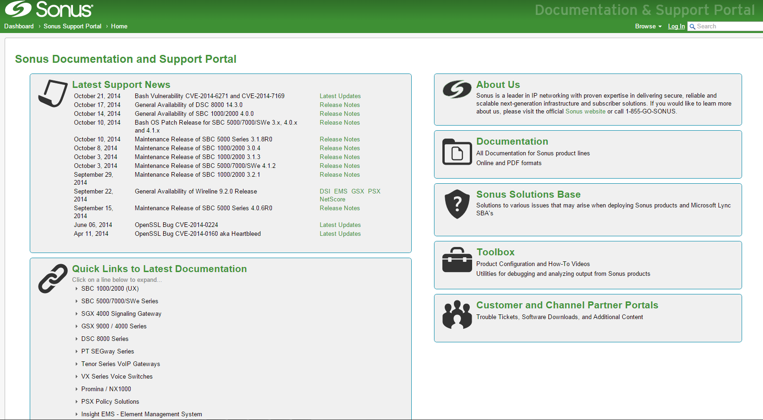
Sonus Global Services Support Portal and Documentation Access

Slide 11
Customer Support
Engaging the Sonus Global Support portal and TAC
Open a TAC case via your SGS portal account
http://support.sonus.net
Call 1-855-GO-SONUS
Must have system serial number ready for SLA verification
8:00 AM to 5:00 PM regular business hours (GMT-5) support
Case is assigned to a TAC engineer and email confirmation sent
After hours 24/7 support for end customer service affecting (live) issues ONLY
Call 1-855-GO-SONUS

Slide 12
Customer Support
Include the following information when reporting issues to Sonus TAC Customer Support
Contact name, e-mail, phone number
Product model (e.g. DSC 8000, x401e, x401, x301, x211)
System serial number, MAC address, and/or license key of affected system
Software version information
Service impact
Detailed problem description

Slide 13
DSC System Capacity
As of version 16.0.0
Item | DSC 8000 (four shelves) | DSC 8000 (single shelf)
SS7 Link Capacity (Logical)
Low-speed Links per system | 4,096 limit for all links combined | 1,008
ATM QSAAL HSL per system | 280 | 56
Unchannelized Annex A HSL per system | 160 | 32
Low-speed Links per I/O Card | 126 | 126
ATM QSAAL HSL per I/O Card | 7 | 7
Unchannelized Annex A HSL per I/O Card | 4 | 4
SIGTRAN M2PA Links per System | 4,096 limit for all links combined | At most 250 SCTP Associations per Routing CPU or VM
SIGTRAN SUA/M3UA Associations | 3,000 | At most 250 SCTP Associations per Routing CPU or VM
Physical TMD Interfaces
I/O Cards per System | 44 | 8
T1/E1 Ports per I/O Card | 8 | 8
Other SS7 Limits
Linksets per system | 4,096 | 4,096
Routesets | 4,096 | 4,096
Routes per Routeset | 8 | 8
Routes per System | 24,000 | 24,000
Virtual Point Codes | 4,500 | 4,500
Network Appearances | 32 | 32
ASP Routing Keys | 1,024 | 1,024
Gateway Screening Records | 20,000 | 20,000
SCTP Associations per Routing CPU | 250 | 250
Management CPUs | 2 | 2

Slide 14
Introduction to the DSC STP
System Overview
Key Features
Deployment Example

Slide 15
System Overview
System built on reliable and stable redundant hardware
Connect to network elements using
Traditional 48/56/64 kbps T1/E1/J1 TDM
ATM HSL
IP-SIGTRAN signaling links (M2UA, M2PA, M3UA, SUA)
Annex A (un-channelized T1/E1)
Provides a feature rich SS7 distribution and scalable SS7 stack supporting many signaling variants
ANSI, ITU, Japan, NZ and so on
TDM network connectivity via T1 (100Ω) and E1 (120Ω)

Slide 16
System Overview
MSU Screening, Redirecting, Accounting
Point Code Network Appearance on both SS7 and IP networks
Point Code Emulation allowing private network expansion
Global Title routing on Called, Calling Party Address or OPC
Signalling Gateway capability for M3UA and SUA
IWF Options for SS7 packet tracing and forwarding
SNMP for real time alarms
Connecting to EMS System
Voice Pass-through for grooming of circuits
Ability to add Diameter routing

Slide 17
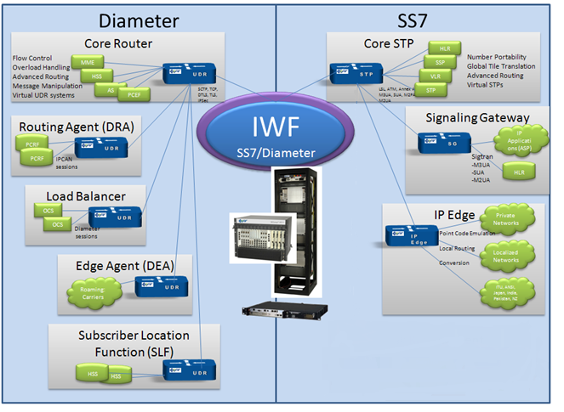
Key Features
All These functions can reside on the same DSC 8000

Slide 18
Deployment Example of STP
DSC 8000 STP
DSC 8000 STP

Slide 19
DSC 8000 System Hardware

Slide 20
DSC 8000 System Hardware
System Hardware
Card Assignments
Chassis Front/Rear View
Overview
Rack
PDU
MCH/CPU/IO cards
Hardware Hot-swap Procedure

Slide 21
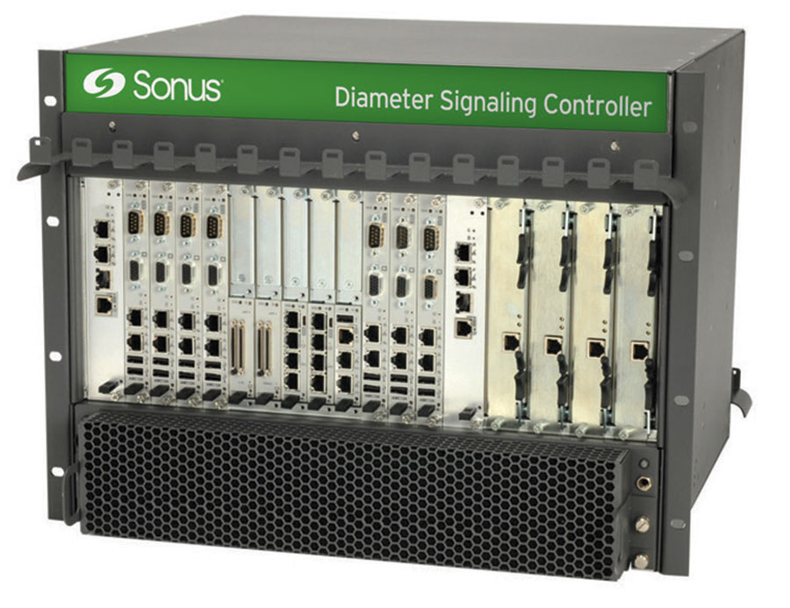
DSC 8000 System Hardware

Slide 22
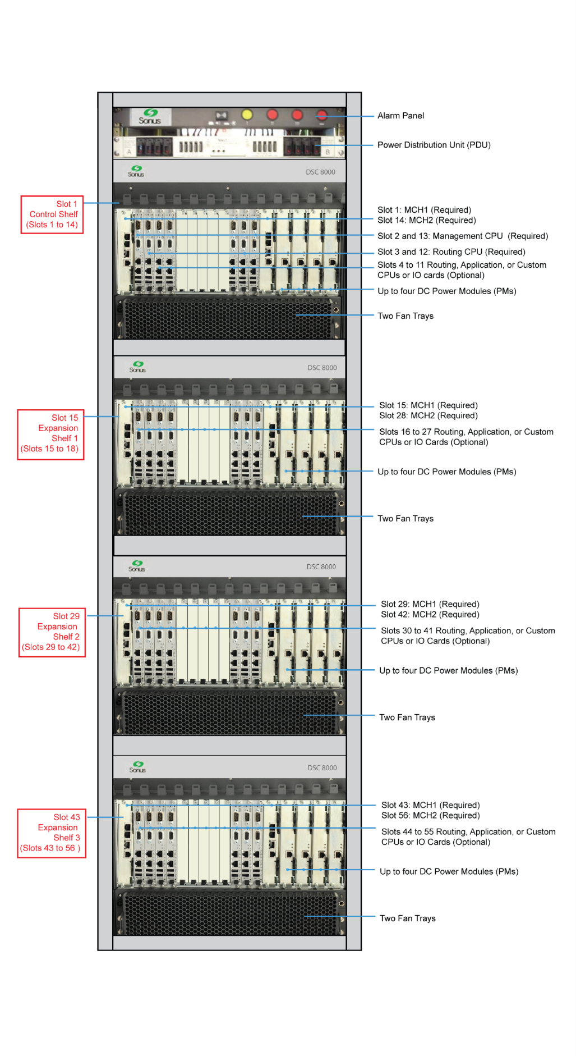
System Hardware
DSC 8000 Shelf
Ethernet Switches and Intelligent Shelf Manager (MCH)
Management and Routing CPUs
Hot Swap Procedures
IO cards
Application / Custom CPUs

Slide 23
Overview
1 to 4 DSC 8000 shelves
microTCA Open Standards
8U platform
System cards in front and Rear Transition Modules (RTMs) in back
Built-in redundancy for all active system components
CPUs, Ethernet Switches / Controller cards, Power Supplies, and Fan Trays
System operates with minimal downtime and auto-recovers in the event of a system card failure
All cards and power supplies are hot swappable
Extract and insert cards in specific order

Slide 24
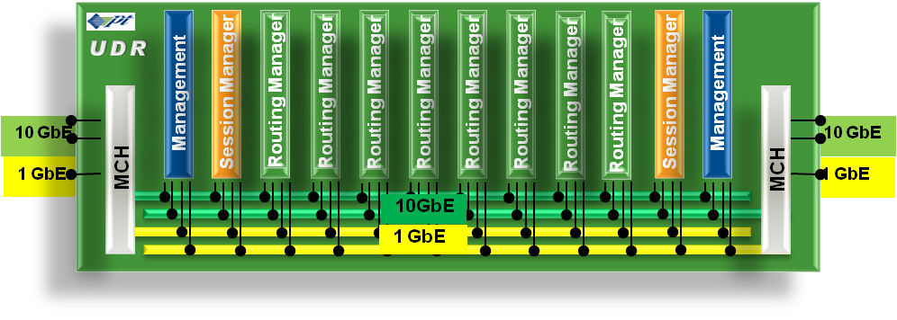

Card Assignments
Management Blades
CMU, KPIs, Logs
MCH
Switch
Chassis Control
Application Blades
SDA Feature Set
Routing Blades
Performs SS7, advanced routing and screening of messages
SCTP peer connections

Slide 25
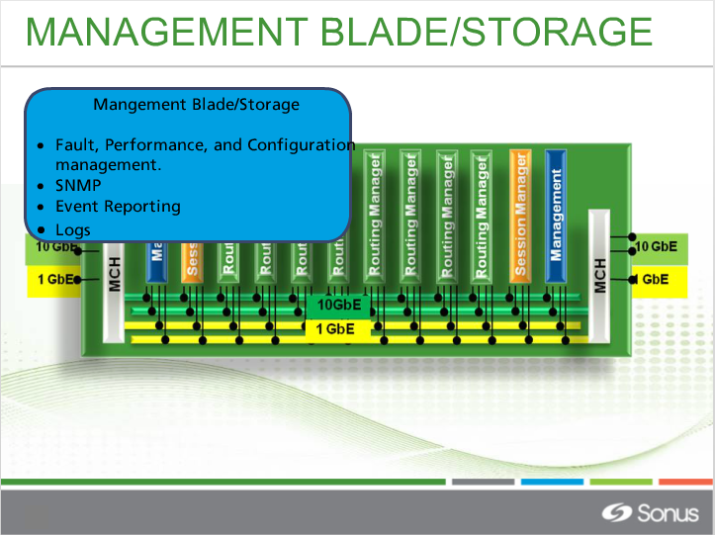

Slide 26
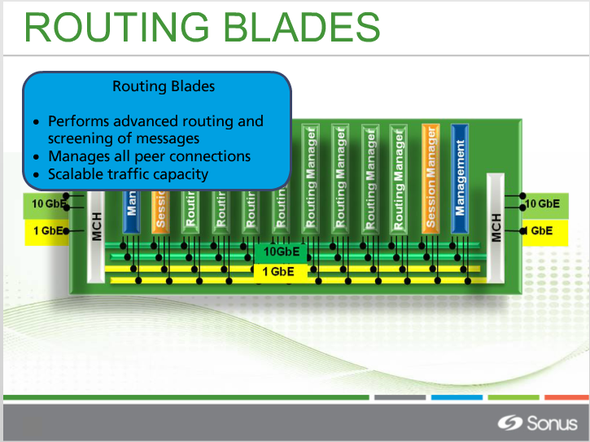

Slide 27
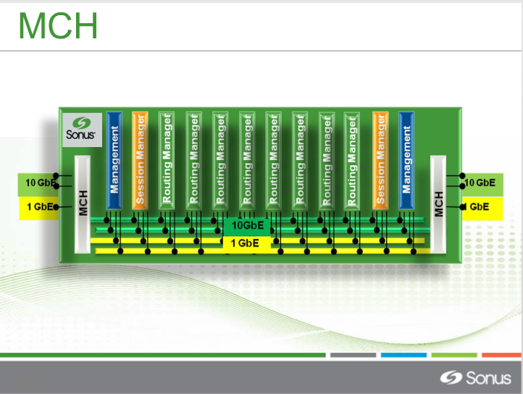

Slide 28
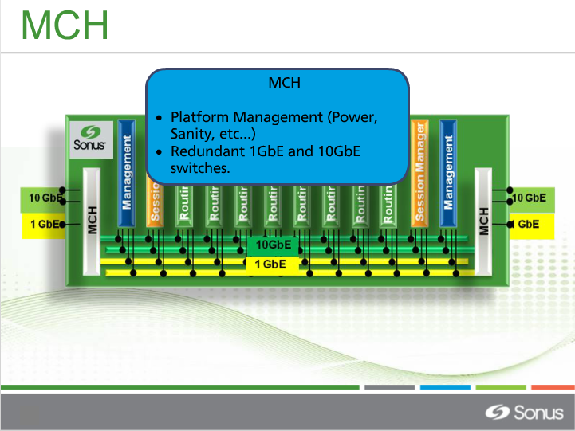

Slide 29
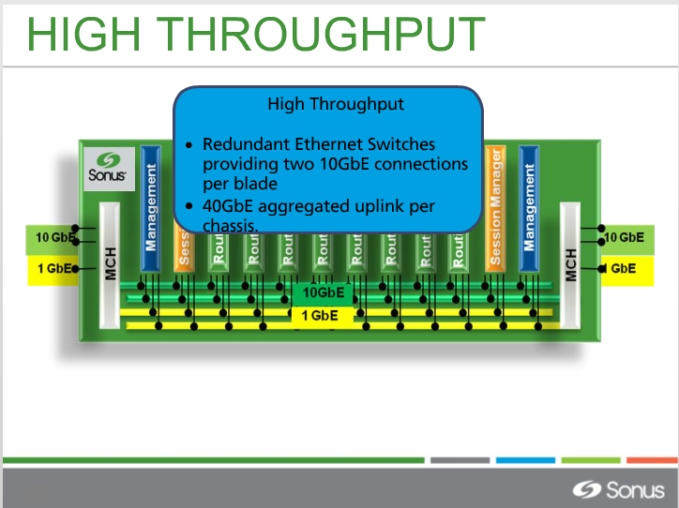

Slide 30
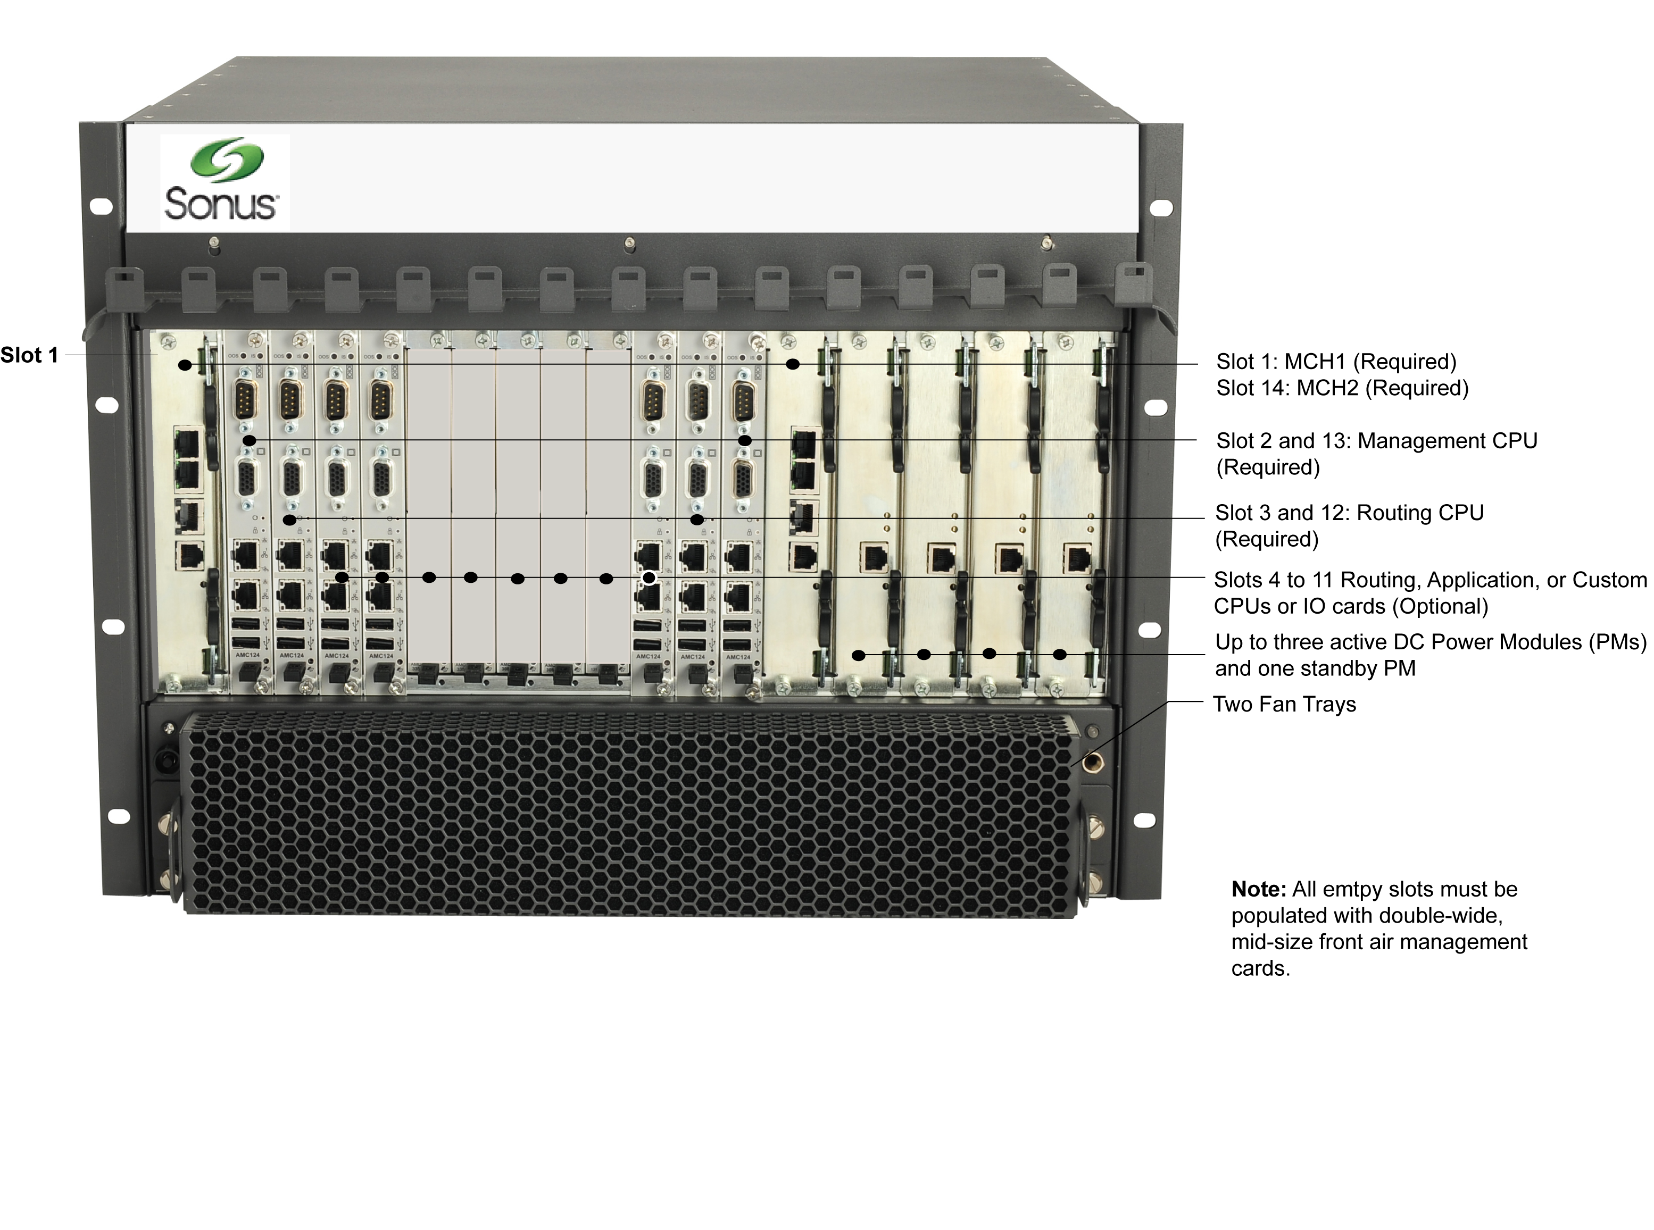
DSC 8000 Chassis – Front View

Slide 31
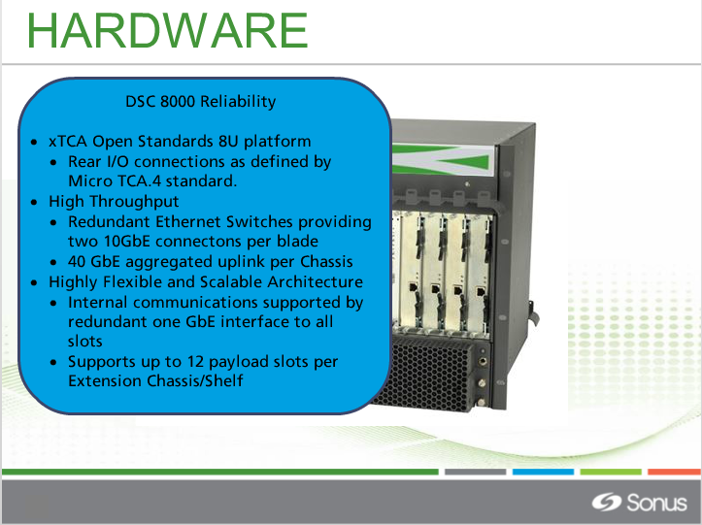

Slide 32
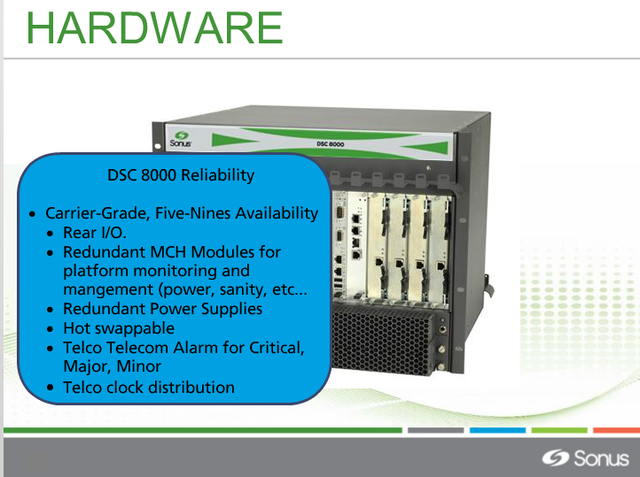

Slide 33
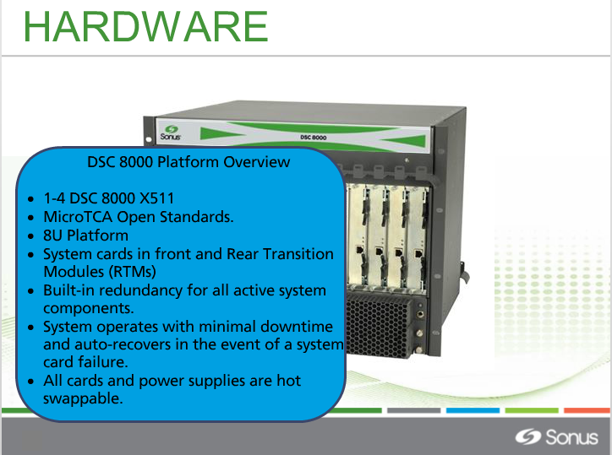

Slide 34
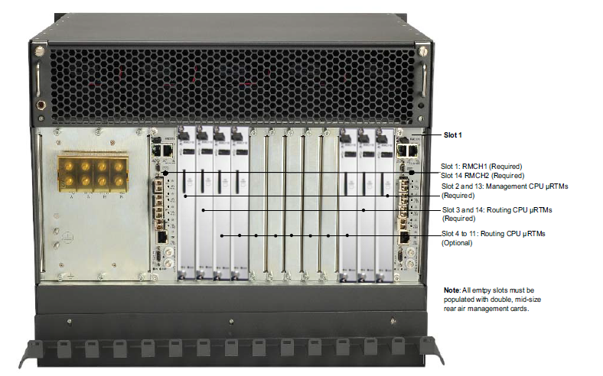
DSC 8000 Chassis - Rear View
Slot 1
Slot 1 & 14: MCH RTM
Slot 2 & 13: OAM CPU RTM
Slot 3&12: Routing CPU RTM
Slots 4 to 11: Additional Optional
CPUs or IOs RTM

Slide 35
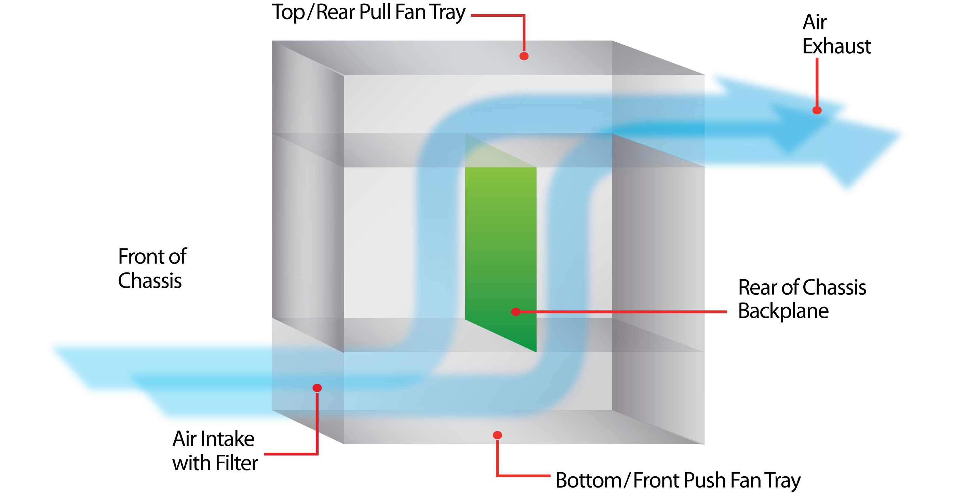
DSC 8000 Chassis - Cooling

Slide 36
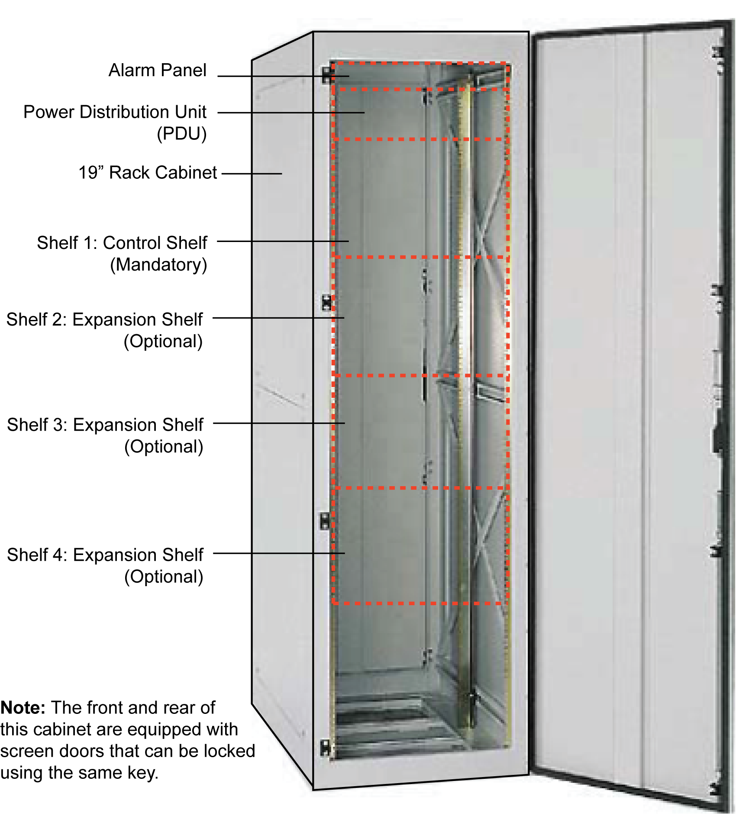
DSC 8000 Rack

Slide 37
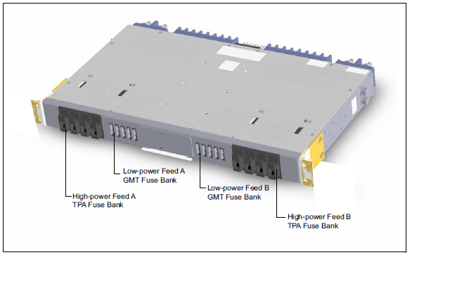
DSC 8000 PDU
DC Powered Power Distribution Unit (PDU)
Dual 200 A 4/5 TPA/GMT fuse panel
Top of rack location
A and B Feed redundancy
8 TPA 50 AMP fuses and 10 GMT positions

Slide 38
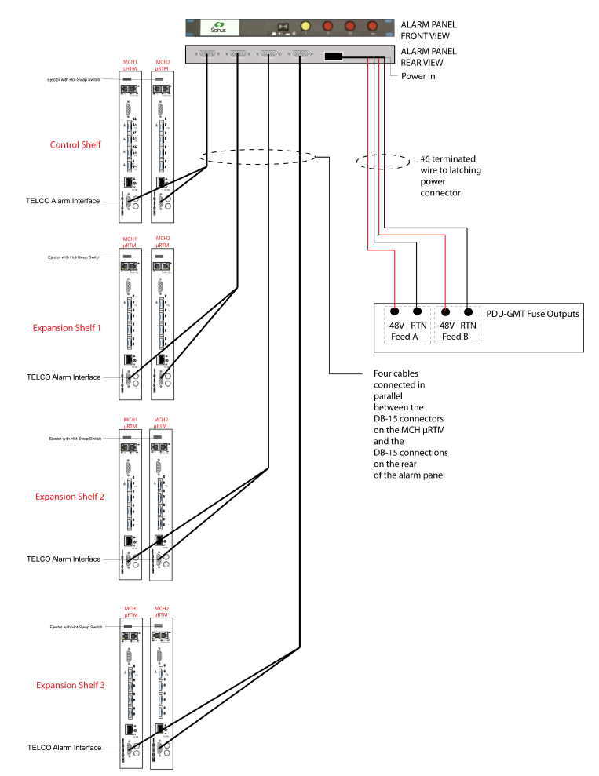
DSC 8000 Alarm Panel

Slide 39
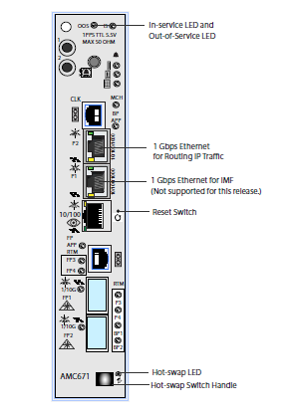
MCH Front (AMC 671)
In Service LED and Out of Service LED
Multi-shelf expansion connections
Hot-swap LED
Hot-swap Switch Handle

Slide 40
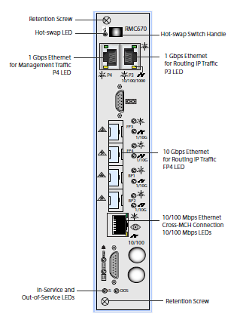
MCH Rear Transition Module (RMC 670)
Hot-swap Switch Handle
P4 – 10/100/1000 Mbps Ethernet for Management traffic. P3 is unused.
FP3 – 1 or 10 Gbps Ethernet for Routing IP traffic (SFP/SFP+Bays)
FP4 – 1 or 10 Gbps Ethernet for Routing IP traffic Standby (SFP/SFP+Bays)
BP2 – 1 or 10 Gbps Ethernet for Routing IP traffic (SFP/SFP+Bays)
10/100 Mbps Ethernet - Cross-MCH Connector (RJ-45 connector)

Slide 41
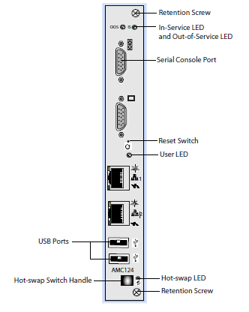
CPU Front (AMC 124)
External IP ports
Unused in DSC 8000

Slide 42
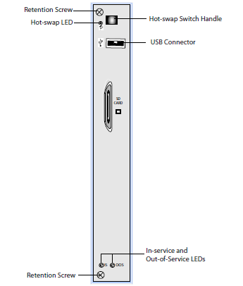
CPU Rear Transition Module (RMC 110)
Management CPU Rear System Cards
one solid state 256 Gb for logs and data measurements
second solid state 256 Gb for applications and root file system
Routing CPU Rear System Cards
one solid state 64 Gb for applications and root file system
External SD Slot
Unused in DSC 8000

Slide 43
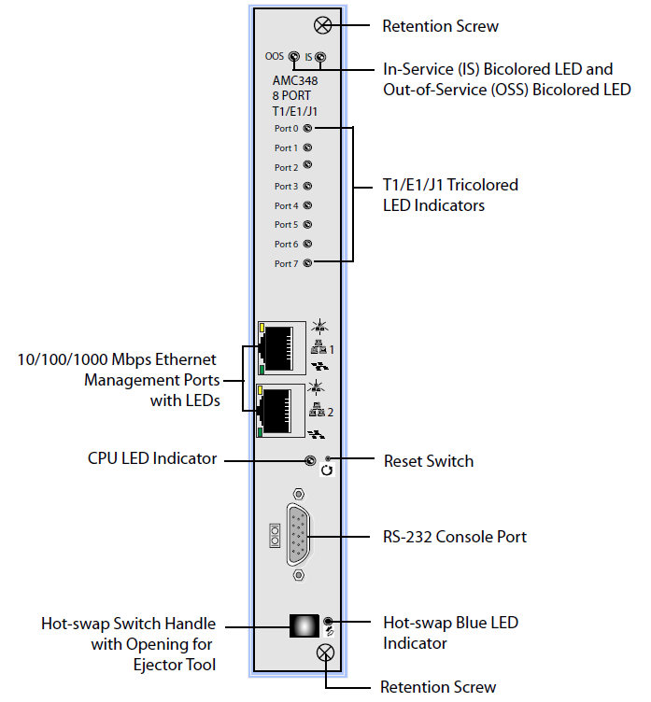
IO T1/E1/J1 (AMC 348)
External IP ports
Unused in DSC 8000
Note: 10/100/1000 Mbps Ethernet Management Ports are not used by the DSC 8000 in normal operation

Slide 44
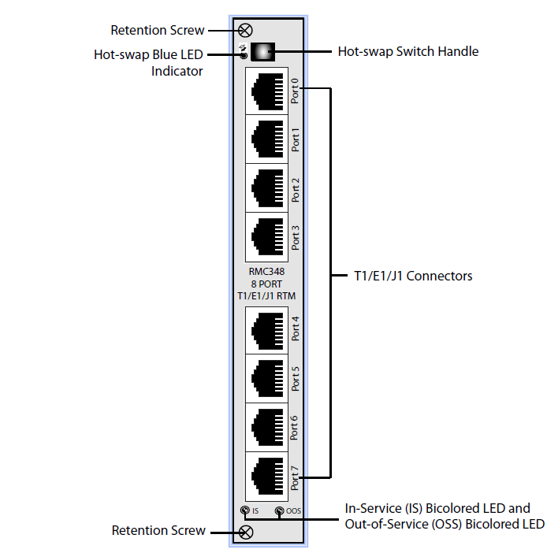
IO T1/E1/J1 (RMC 348)

Slide 45
Hardware Hot-Swap Procedure
To extract a card from the system, certain procedures should be followed to avoid software corruption and/or damage to the cards.
Stop all software on the card to be removed. This can be done on a per card basis via the CMU.
Unscrew/Loosen retention screws on Rear System Card and Front System card
Extract the Rear System Card
Extract the Front System Card
Insert the Front System Card – ensure screws are fastened
Insert the Rear System Card – ensure screws are fastened Note: This procedure is also described in the Hardware Installation and Initial Configuration Guide.

Slide 46
DSC 8000 SWe

Slide 47
DSC SWe
DSC Platform Dual Deployment Configurations
The dual configuration consists of either one of the following DSC platform deployment scenarios:
One VM Instance created in virtual “slot1” on a KVM/VMware Host, and another VM Instance created in virtual “slot2” on a separate KVM/VMware Host.
Additional VMs may be added for capacity expansion
In both scenarios, communication between the VMs is through the High Availability (HA) interface. This is physically cabled between machines.

Slide 48
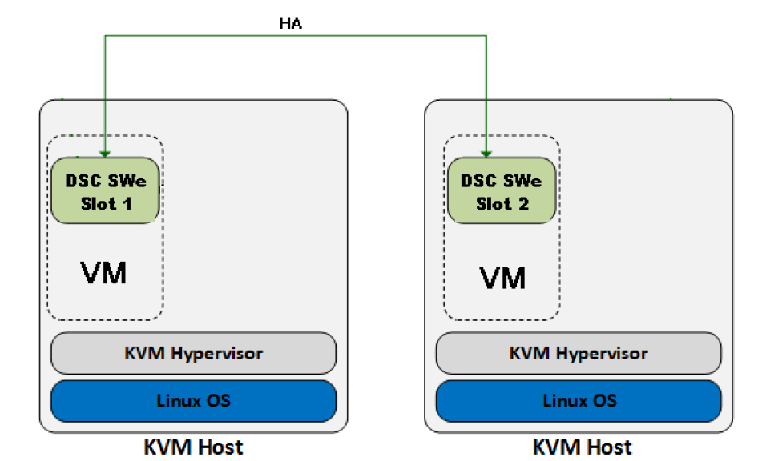
DSC SWe - KVM Example 1

Slide 49
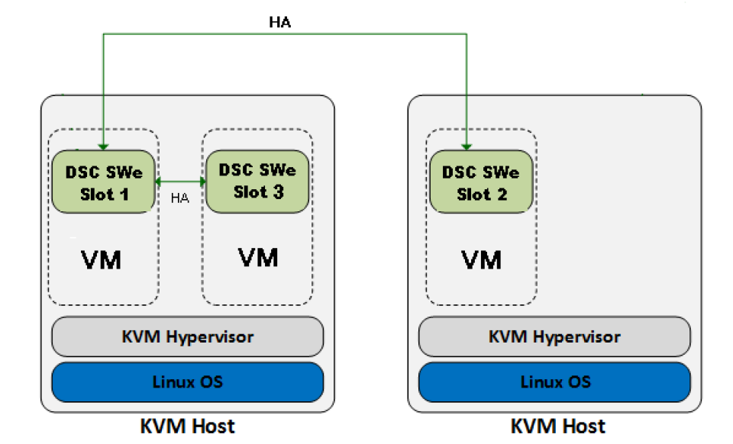
DSC SWe - KVM Example 2

Slide 50
DSC 8000 System Software

Slide 51
System Software
System Architecture
Interprocess Communications
Software Processes
Directory Structure
User Interfaces

Slide 52
System Software Architecture
Software and configuration resides on each CPU’s Solid State Disk
Logs and Statistics are written to the second solid state disks on both Management CPUs
Operating system is based on LINUX Fedora Core
A minimum of three IP addresses are required for remote management access to the DSC 8000
Additional IPv4 or IPv6 addresses can be configured for SCTP or TCP over IP connections for Diameter or SS7

Slide 53
External IP Ports
Card | Slots | Internal Interface | Port Number (Physical on MCH)
OAM | 2 | P19p1.3 P19p1.3:0 | P4 (10/100/1000 Mbps)
OAM | 13 | P19p2.5 P19p2.5:0 | P4 (10/100/1000 Mbps)
Routing (Mandatory) | 3 12 | P19p1.2 P19p.2.4 P19fp1.2 P19fp2.4 P19p1.6 (IMF) P19p2.7 (IMF) | FP3 or FP4 STDBY (1Gbps or 10Gbps) BP2 (1Gbps or 10Gbps)
Routing (Optional) | 4 11 | P19p1.2 P19.2.4 P19fp1.2 P19fp2.4 P19p1.6 (IMF) P19p2.7 (IMF) | FP3 or FP4 STDBY (1Gbps or 10Gbps) BP2 (1Gbps or 10Gbps)
For other Routing Cards, VLANs and more, see System Management Guide.

Slide 54
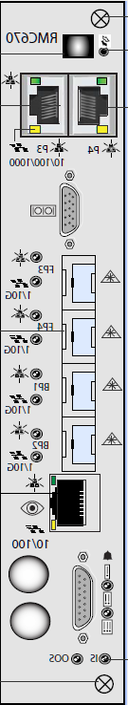
External IP Ports
Slot13
MGMT
Slot12
RTNG
Slot11
CPU or IO
Slot10
CPU or IO
Slot9
CPU or IO
Slot8
CPU or IO
Slot7
CPU or IO
Slot6
CPU or IO
Slot5
CPU or IO
Slot4
CPU or IO
Slot3
RTNG
Slot2
MGMT
MCH2
MCH1
Cable1 to Router
(MGMT Traffic)
P4
P19p2.5
P19p1.3
P4
Cable2 to Router
(MGMT Traffic)
P19p1.2
P19p1.2
P19p1.2
P19p1.2
P19p1.2
P19p1.2
P19p1.2
P19p1.2
P19p1.2
P19p1.2
Cable3 to Router
(Routing Traffic)
FP3
P19p2.4
P19p2.4
P19p2.4
P19p2.4
P19p2.4
P19p2.4
P19p2.4
P19p2.4
P19p2.4
P19p2.4
FP3
Cable4 to Router
(Routing Traffic)
FP4
FP4
Cable6 to Router
(Routing Traffic
Optional STBY link)
Cable5 to Router
(Routing Traffic
Optional STBY link)
BP2
P19p1.3
P19p1.3
P19p1.3
P19p1.3
P19p1.3
P19p1.3
P19p1.3
P19p1.3
P19p1.3
P19p1.3
BP2
Cable8 to Router
(IMF Traffic)
Cable7 to Router
(IMF Traffic)
P19p2.5
P19p2.5
P19p2.5
P19p2.5
P19p2.5
P19p2.5
P19p2.5
P19p2.5
P19p2.5
P19p2.5
AMC12
AMC11
AMC10
AMC9
AMC8
AMC7
AMC6
AMC5
AMC4
AMC3
AMC2
AMC1
MCH Interconnect
All network connections are done at the rear of the chassis.

Slide 55
System Software Directory Structure
/root
current
Current files
switch_ss7gw
previous
Old files
/opt
cpu_ss7gw
current
Current files
/home
previous
Old files
io_ss7gw
current
Current files
Temp files
previous
Old files
/tmp
System stats
compressed
/var
Backups
/log
System logs
archives

Slide 56
Inter-Process Communication
CPU 1
CPU 2
Process A
Process A
Process B
Process B
Process C
Process C
Service Connection TCP Peer connection TIPC External Connection TCP or SCTP Message Flow

Slide 57
Software Survivability
CPU 1
CPU 2
Process A
Process A
Unavailable process
Process B
Process C
Process C
Peer connection Service Connection External Connection Message Flow

Slide 58
Software Processes
Process | Description
MTP2 | Message Transfer Part Level 2: Implements message transmission across SS7 links
SNM (MTP Level 3) | Signaling Network Management: Handles MTP3 traffic and route management
DRE (MTP Level 3) | Distributed Routing Engine: Processes SS7 messages according to rules received from the SNM
SCCP | Signaling Connection Control Part: Processes distribution of messages based on either a subsystem number or a Global Title (GT)

Slide 59
Software Processes
Process | Description
GWST | Gateway Screening either blocks or allows messages to pass through the system, based on user configured rules
GTT | Global Title Translation (GTT) enables GT routing, and processes GT queries with a Destination Point Code (DPC) of either the Local Point Code (LPC), or an alias PC
PCE | Point Code Emulation divides a network into public and private addressing spaces
Signaling Gateway (DINAMO) | Provides MTP or SCCP user part primitive adaptation using M3UA or SUA
L4 Converter | Provides protocol conversion between two SS7 variants

Slide 60
User Access (UPP)
Four available User Profiles and Privileges (UPP):
MONITOR – Read-only access
SS7_ADMIN – SS7 and DSC Diameter administration, no system write access (root required)
MTP_OPERATOR – MTP2, MTP3 and DSC Diameter, no application write access (root required)
SCCP_OPERATOR – SCCP Administration, no MTP2, MTP3, DSC or system write access (root required), can add IP Routes.
New Users Assigned UNPROFILED (read-only)
Only one “root” level user is permitted per system.

Slide 61
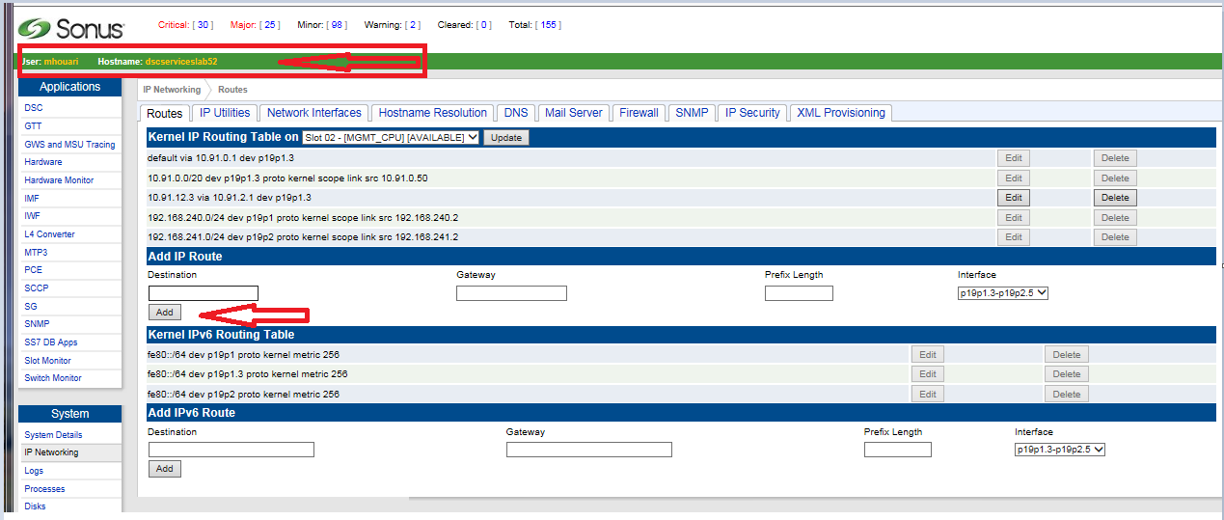
User access – SCCP_Operator Profile - Continue
Users with SCCP_OPERATOR profiles can only configure the SCCP application, but can add, edit, and delete any IP routes.
Users with MONITOR or UNPROFILED profiles can only view IP routes.

Slide 62
Available User Interfaces
The following User Interfaces (UI) are supported:
Text-based User Interface (menuUI)
This interface is limited and only used for the initial configuration and upgrades on the DSC 8000
Configuration Management Unit (CMU or webUI)
Transaction Language 1 (TL1)
Simple Network Management Protocol (SNMP)
XML Input

Slide 63
User Interfaces (Menu UI)
Supported ONLY for initial system configuration and Upgrades
Starting Main Menu as root
Login as root (default password: changeme)
Type CLI command: startmenu
When logged in, the Main menu appears instantly
Exiting Main Menu
Select Logout
The session returns to the CLI

Slide 64
User Interfaces (Menu UI)
Main Menu for root at startup
Note: The Main menu will be different after the initial configuration
Main Menu
Sonus Networks DSC 8000
1 - System
2 - Configure Network Interfaces
3 - Set Initial Configuration
4 - Restore
5 - Enter Shell
l - Logout
Enter Selection:
User: root Hostname: localhost

Slide 65
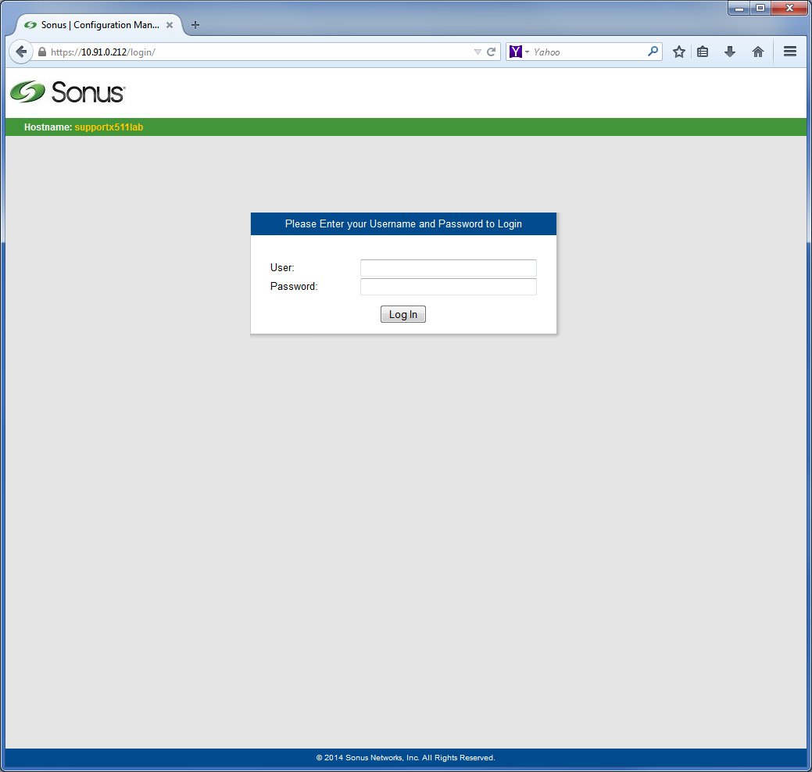
CMU (webUI) - Logging On
The webUI, referred to as Configuration Management Unit (CMU) in this training course is presented as a secured simplified navigation for the DSC 8000
CMU
HTTPS Secure Web-based interface (all users)
Easy access to system, hardware, and configuration
Accessed using a Web browser supporting HTTPS
Starting the CMU
Open a secure Web browser application
Type the management IP address as the URL

Slide 66
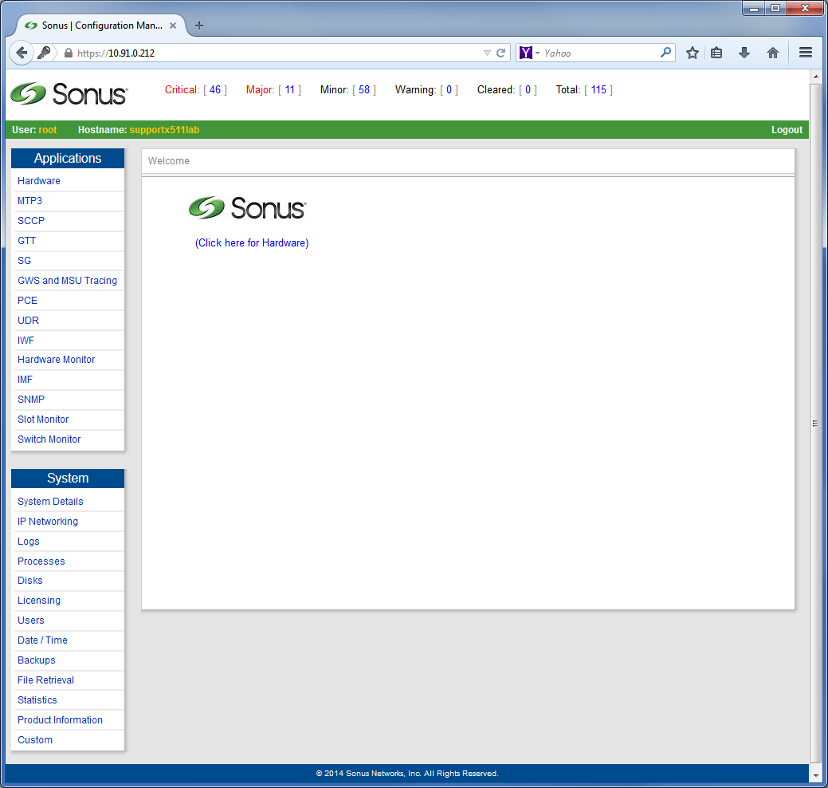
CMU - Main Menu
User ID and host are identified on status bar
Main Menu displays Alarm Banner, Applications Menu and System Menu

Slide 67
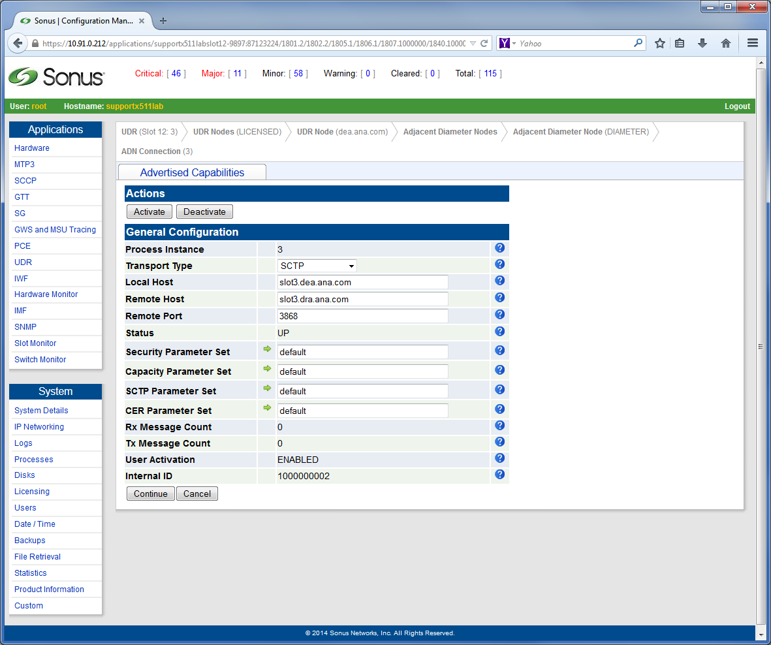
CMU, Screen Layout Example
Alarm Dashboard
Current userID and
Node address
Current working location in
the configuration tree
Action buttons
Top menu bar
Application menu
Provisioning area
and other related
screens (if applicable)
System menu

Slide 68
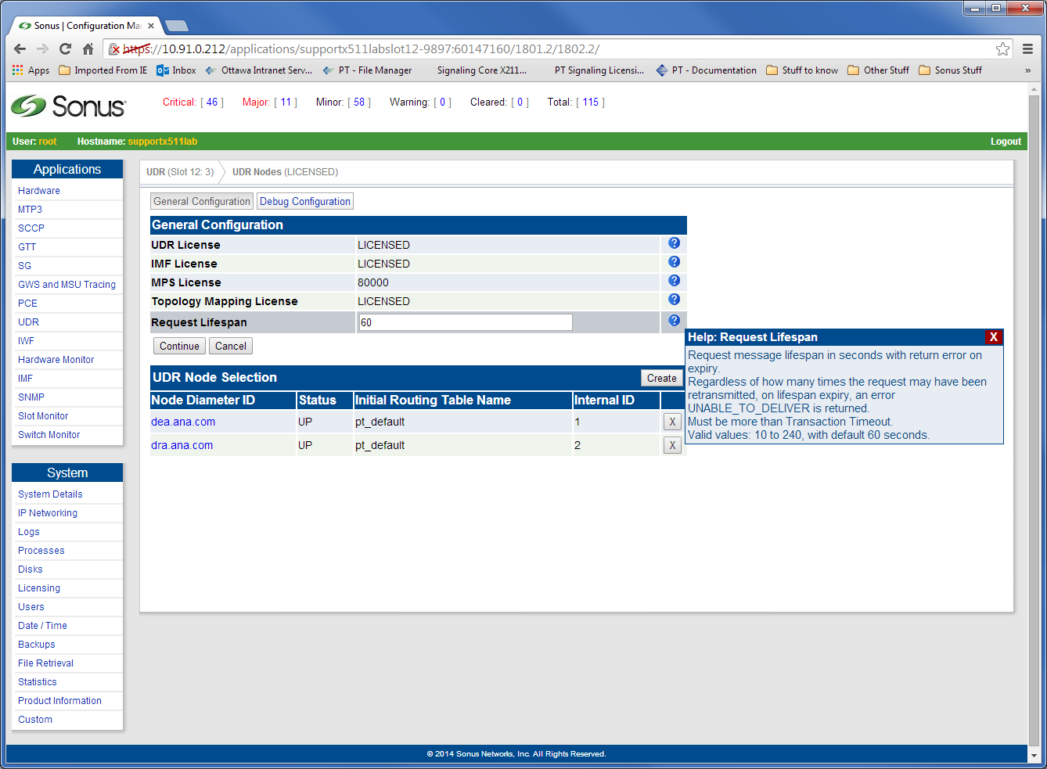
CMU, Context-sensitive Help
To display online help, place mouse pointer over the question marks
The help text for the specific parameter is displayed

Slide 69
TL1
Transaction Language 1 (TL1)
ASCII-based instructions sent by operator to a network element
Widely used language to manage network elements
TL1 interface reachable via SSH to management IP, then internal Telnet session on port 6669
TL1 session permits configuration of applications on the DSC 8000
Note: The Set Initial Configuration must be completed before accessing the TL1 interface.
Note: TL1 restriction of the root password. The character “@” should not be use in the root password if you are planning to use TL1 for bulk loading/activation.

Slide 70
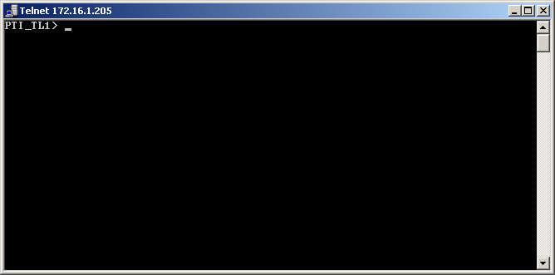
TL1
To connect to TL1 interface, access the DSC 8000 using SSH
Then run ‘telnet localhost 6669’
TL1 command syntax
<Verb>-<Modifier1>-<Modifier2>:[TID]:[AID]:[CTAG]:[GeneralBlock];
To disconnect type quit at the prompt
PTI_TL1> quit;

Slide 71
TL1 Examples
SET-ATM-LINKMGR (Activate or Deactivate ATM Link Manager)
SET-ATM-LINKMGR::9:abc:::::ACT;
ADD-SUA-CONFASP (Add Configured SUA ASP)
ADD-SUA-CONFASP::213:abc:::::ID=213,IP1=10.81.1.09,
IP2=,PORT=2222;
CHG-GWST-ALWCLGPA (Change Allowed Calling Party Attributes for GWST)
CHG-GWST-ALWCLGPA::3-240.115.6-251-ANYANY:
abc:::::REMARK=change,NEXT_TABLE=ALLOWED SCCP
CLDS,NEXT_EPR=9,SS7_VARIANT=ANSI,MSU_TRACING=DISABLED,SCREEN_TEST_MODE=DISABLED;

Slide 72
SNMP
Simple Network Management Protocol (SNMP)
Allows management of most objects
Provides effective method of alerting SNMP managers of specific conditions on a DSC 8000 system
Requires third party SNMP management system
Supports set, gets and walks

Slide 73
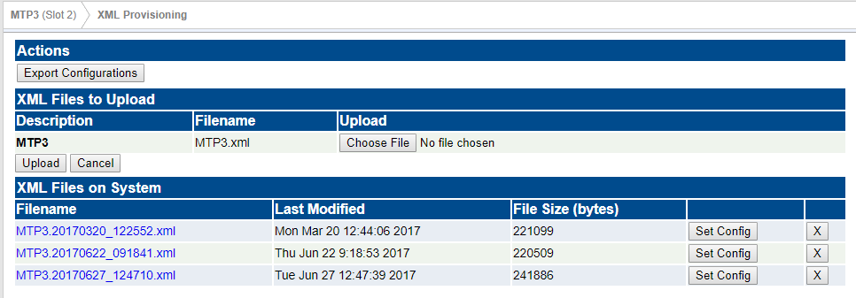
XML
Refer to Application Guides 1 and 2 for Configuring the DSC with XML files. MTP example at:
https://support.sonus.net/display/DSCDOC160/Configuring+MTP3+Using+XML

Slide 74
Initial System Configuration

Slide 75
Initial System Configuration
Initial System Configuration
Licensing
IP Networking
Set Initial Configuration
EMS configuration
Configuring System Date and Time
Managing Users

Slide 76
Initial System Configuration
New systems must be initialized to enable remote access and activate the DSC 8000 software
A local console connection is mandatory to configure network interfaces for remote access
No default IP’s are assigned

Slide 77
Initial System Configuration
The following steps must be performed during installation
Add license keys
Configure Network Interfaces and hostname
Initialize internal configuration
Set system date, time, and Time Zone
Add new users and passwords (optional)

Slide 78
Licensing
License keys are text strings encoded using eth0 MAC address of CPUs
They are designed for their intended systems only
They enable or disable features on the system
A license letter ships with each DSC 8000 system
A valid license key is required to run the DSC 8000 software
New keys are purchased to upgrade capabilities

Slide 79
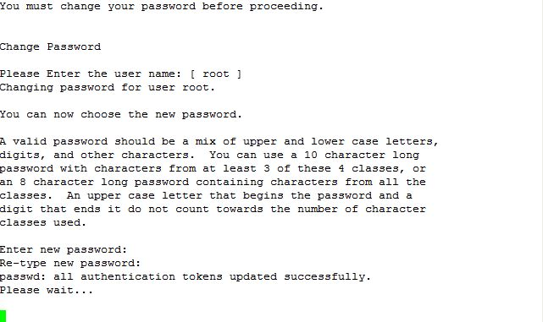
Licensing
Logon to the system
At the prompt, Enter root
Enter changeme
Enter startmenu
Change the password by following the prompts.

Slide 80
Licensing
Navigate to the Main Menu and select Licensing. Select Add License.
Read the agreement pressing the ENTER key repeatedly to advance to the end of this agreement.
Enter yes and then press ENTER.
Licensing
1 - License Information
2 - Add License
3 - MAC addresses and Serial Numbers
b - Back
l - Logout
Enter Selection: 2
User: root Hostname: localhost

Slide 81
Licensing
You are presented with two choices:
Choice #1
You can open a separate window on the same system, enter/copy the license keys into a text file with the file name license.key and place this file into the /tmp directory.
After you entered/copied the license keys into a text file with the file name license.key and place this file into the /tmp directory, go to the window that you are using for this procedure.
Press ENTER when prompted.
Enter the license keys one at a time for the displayed MAC Address. After each license key has been entered, press ENTER to start a new line for the next license key.
Press keys. The system automatically upgrades the CPUs with the liENTER twice when all license keys have been entered to end the registration of license cense information.
If the message shows that the license keys were successfully activated, press ENTER to proceed with other provisioning activities

Slide 82
Licensing
Choice #2
You can enter the license keys one at a time.
Press ENTER when prompted.
Enter the license keys one at a time for the displayed MAC Address. After each license key has been entered, press ENTER to start a new line for the next license key.
Press ENTER twice when all license keys have been entered to end the registration of license keys. The system automatically upgrades the CPU cards with the license information.
If the message shows that the license keys were successfully activated, press ENTER to proceed with other provisioning activities Note: In case of difficulties, contact Customer Support.

Slide 83
Licensing
License Information
(ROUTING – slot_3)
8 Network Appearances (NAs) allowed
12 M2PA links allowed
4 SS7 high speed links (ATM) allowed
12 M2UA links allowed
32 SS7 low speed links allowed
MTP STP Routing allowed
SCCP allowed
MTP Virtual Point Codes (VPC) allowed
Distribution allowed
(ROUTING – slot_8)
8 Network Appearances (NAs) allowed
12 M2PA links allowed
4 SS7 high speed links (ATM) allowed
12 M2UA links allowed
32 SS7 low speed links allowed
MTP STP Routing allowed
SCCP allowed
MTP Virtual Point Codes (VPC) allowed
Distribution allowed
Press q to quit, h for help
To view licensed features, select License Information
Navigate to the Main Menu, and select License Information

Slide 84
Network Interfaces
IP Networking configuration consists of three tasks
Configuring the Network Information - hostname and domain name
Configuring the SIGTRAN IP network interfaces
Configuring the Management network interfaces
Configuring the IMF IP network interfaces
Corresponding CPUs and/or services restart after configuration
Note: It is recommended that you configure the Management and SIGTRAN SS7 IP network interfaces during the initial configuration process; however, you can configure the IMF IP network after the fact if required using the Web UI.

Slide 85
Network Interfaces
Main Menu
Sonus Networks DSC 8000
1 - Licensing
2 - Configure Network Interfaces
3 - Set Initial Configuration
4 - Restore
5 – Software Revisions
6 - Enter Shell
l - Logout
Enter Selection: 2
User: root Hostname: localhost
From the Main Menu, select Configure Network Interfaces
Select Network Information
Network Configuration
[Press CTRL-C to abort and return to the previous screen]
1 - Network Information
2 - SS7/IP Network
3 - Management Network
4 - Restart networking
b - Back
Enter Selection: 1

Slide 86
Network Interfaces
Enter a hostname and a valid domain name
Max of 32 alphanumeric characters
First character MUST be a letter
Limited use of special characters
Enter y and press ENTER to confirm
Setting Network Information
[Press CTRL-C to abort and return to the previous screen]
Default values (if any) will appear at the end of a line in
square braces ([]). Press <enter> to select the default value.
To clear a value, or enter no value, enter a '.' and press enter.
Please enter the hostname: [devX40x]
Please enter the domain: [lab.ottawa.sonus.com]
Hostname: devX40x
Domain: lab.ottawa.sonus.com
Is this correct? [y/n] y

Slide 87
Network Interfaces
The IP services are automatically restarted
Stopping High-Availability services:
[ OK ]
Waiting to allow resource takeover to complete:
[ OK ]
Starting High-Availability services:
[ OK ]
Stopping High-Availability services:
[ OK ]
Waiting to allow resource takeover to complete:
[ OK ]
Starting High-Availability services:
[ OK ]
Press <enter> to continue.

Slide 88
IP Networking (SS7 IP)
Two IPv4/IPV6 addresses per CPU allow for multi-homed associations in SCTP.
Minimum of Two IP’s are required for Diameter/SS7, One on each routing CPU.
IPv4 / IPv6 can use one or more IP’s. Dual homed vs single homed associations
IPv6 can use a multitude of IP aliases

Slide 89
IP Networking (SS7 IP)
Network Configuration
[Press CTRL-C to abort and return to the previous screen]
1 - Network Information
2 - SS7/IP Network
3 - Management Network
4 - Restart networking
b - Back
Enter Selection: 2
From the Main Menu select Configure Network Interfaces
Select SS7/IP Network
Select the CPU to configure
Configure SS7/IP Network
[Press CTRL-C to abort and return to the previous screen]
Configure SS7/IP Network on which card ?
1 - ROUTING – slot3_0
2 - ROUTING – slot8_0
b - Back
Enter Selection: 1

Slide 90
IP Networking (SS7 IP)
Select the Ethernet interface to configure
Enter the appropriate IP information at the prompts
Network Configuration for ROUTING – slot3_0.
[Press CTRL-C to abort and return to the previous screen]
1 - Ethernet port 1 (p19p1.2)
2 - Ethernet port 2 (p19p2.4)
b - Back
Enter Selection: 1
Configuring Ethernet Port ss70
[Press CTRL-C to abort and return to the previous screen]
Default values (if any) will appear at the end of a line in
square braces ([]). Press <enter> to select the default value.
To clear a value, or enter no value, enter a '.' and press enter.
Please enter the IP address: 192.168.10.205
Please enter the netmask: 255.255.255.0
Please enter the broadcast address: 192.168.10.255
Please enter the network: 192.168.10.0
Please enter the gateway address: 192.168.10.1

Slide 91
IP Networking (SS7 IP)
Enter y to confirm the information is correct
A reminder about restarting networking is shown
Press ENTER, and repeat for interface eth1.4
Configuring Ethernet Port ss70
[Press CTRL-C to abort and return to the previous screen]
IP Address: 192.168.10.205
Netmask: 255.255.255.0
Broadcast: 192.168.10.255
Network: 192.168.10.0
Gateway: Configuring Ethernet Port ss70
Is this information correct? [y/n] y
Configure Network Interfaces
[Press CTRL-C to abort and return to the previous screen]
Networking will need to be restarted on ROUTING – slot3_0
for changes to be activated.
Press <enter> to continue.

Slide 92
Management Network (O&M) Configuration
Management IP access on MCH port on each Ethernet switch - same subnet
Must assign 3 IP addresses on this subnet
Interface P19p1.3 for MGMT CPU slot 2
Interface P19p2.5 for MGMT CPU slot 13
Interface P19p1.3:0 or P19p2.5:0 are shared IP’s
The shared IP address is used for remote management of the DSC 8000 system
One Ethernet cable per Ethernet switch, combined with a shared IP address, insures remote access stability

Slide 93
Management Network Configuration
Main Menu
Sonus Networks DSC 8000
1 - Licensing
2 - Configure Network Interfaces
3 - Set Initial Configuration
4 - Restore
5 – Software Revisions
6 - Enter Shell
l - Logout
Enter Selection: 2
User: root Hostname: devX40x.lab.ottawa.sonus.com
From the Main Menu, select Configure Network Interfaces
Select Management Network
Network Configuration
[Press CTRL-C to abort and return to the previous screen]
1 - Network Information
2 - SS7/IP Network
3 - Management Network
4 - Restart networking
b - Back
Enter Selection: 3

Slide 94
Management Network Configuration
Enter IP configuration parameters as prompted
Enter y when prompted to restart networking on both CPUs
Network Configuration for the Management Interfaces
[Press CTRL-C to abort and return to the previous screen]
To complete this configuration you need three IP addresses on the
same subnet, as well as the netmask and gateway address. Also, both
cards in slot 2 and 9 must be present for the configuration to
work, as information must be collected from both systems.
Please enter p19p1.3 IP address on slot 2: 10.1.1.248
Please enter p19p2.5 IP address on slot 13: 10.1.1.249
Please enter the management IP address (shared): 10.1.1.247
Please enter the gateway: 10.1.1.1
Please enter the netmask: 255.255.255.0
The following information has been entered
p19p1.3 on slot2: 10.1.1.248
p19p2.5 on slot13: 10.1.1.249
Management ip address: 10.1.1.247
Gateway: 10.1.1.1
Netmask: 255.255.255.0
Is this information correct? (y/n) y
Please wait…
Would you like to restart networking on both management cpus so that
the changes that were made could be activated? (y/n) y

Slide 95
Management Network Configuration
The IP services are restarted on both Management CPUs
Stopping High-Availability services: [ OK ]
Waiting to allow resource takeover to complete: [ OK ]
Starting High-Availability services:
2008/03/20_08:23:02 INFO: IPaddr Resource is stopped [ OK ]
Stopping High-Availability services: [ OK ]
Waiting to allow resource takeover to complete: [ OK ]
Starting High-Availability services:
2008/03/20_08:23:31 INFO: IPaddr Resource is stopped [ OK ]
Press <enter> to continue.

Slide 96
Internal Configuration
The Set Initial Configuration script configures internal data files according to the entered license keys
This process also enables remote access (SSH, sFTP, HTTPs)
From the Main Menu, select “Set Initial Configuration”
Main Menu
Sonus Networks DSC 8000
1 - Licensing
2 - Configure Network Interfaces
3 - Set Initial Configuration
4 - Restore
5 – Software Revisions
6 - Enter Shell
l - Logout
Enter Selection: 3
User: root Hostname: devX4E.lab.ottawa.sonus.com

Slide 97
Internal Configuration
Enter y to configure the applications files
When completed, the Main Menu changes to the post-initialization version
Please wait. Reading license.
This script will configure the system applications data files
Do you wish to continue? [y/n] y
Please wait...
Synchronizing and starting the applications.
It will take a few minutes before the applications get started.
Press <return> to continue.
Main Menu
Sonus Networks DSC 8000
1 - Applications
2 - System
3 - Enter Shell
l - Logout
Enter Selection:

Slide 98
EMS Support for DSC 8000 and SWe
During the initial system configuration setup of the EMS system can be allowed.
The 10.0.x Sonus Element Management System (EMS) can be used to manage the DSC Platforms. You can enable EMS access using the following two methods.
Executing the initial configuration procedure. For more information about this procedure, see the following references.
for the DSC 8000, see the preceding procedure
for the DSC Swe on KVM hypervisor, see Executing the Initial Configuration (on KVM Hypervisor)
for the DSC Swe on VMware hypervisor, see Executing the Initial Configuration (on VMware Hypervisor)
Using the Web UI (see Enabling EMS Access Using the Web UI)

Slide 99
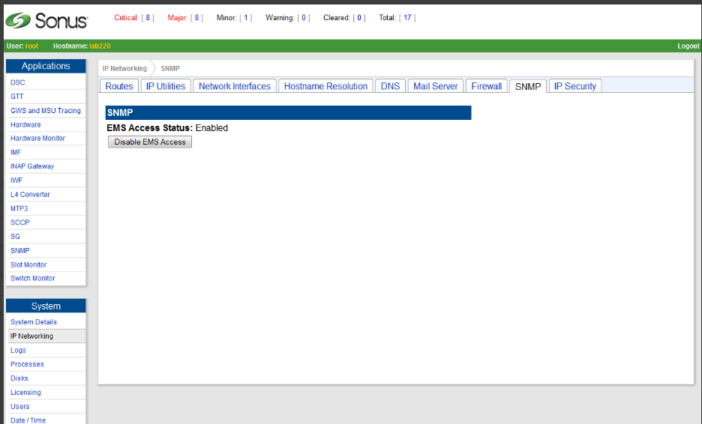
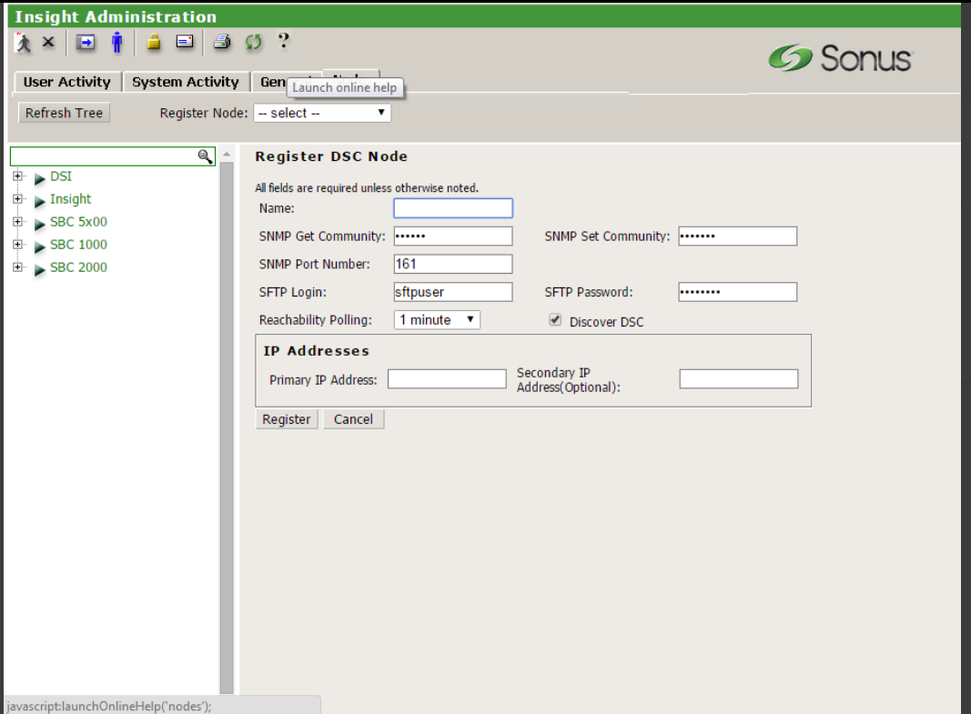
Enable EMS from DCS800 WebUi and The EMS GUI

Slide 100
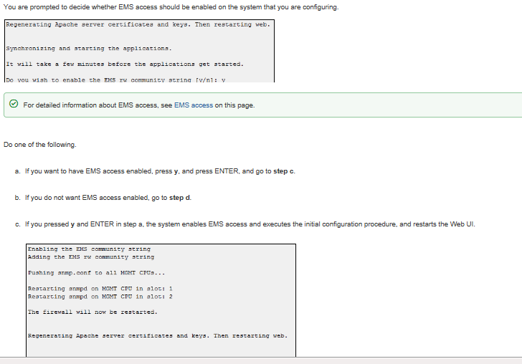
EMS Initial System Configuration - Continue
During the execution of “Initial System Configuration” from the console prompt – you will be asked to enable the EMS community string.

Slide 101
Configuring System Date and Time
Important to set the time and date during the initial installation
Not recommended to change on a live system with traffic
Only required to set date/time on one Management CPU
Built-in internal NTP servers and clients synchronize time system-wide (CPUs, I/O cards, ISMs) Note: May take up to 5 minutes for all cards to initially synchronize time
Optionally configure Network Time Protocol (NTP) NTP clients on Management CPUs to synchronize system time accurately from external NTP server(s)

Slide 102
Setting the Time Zone
Configuring the time zone
From System menu, select Date/Time
From Date/Time menu, select Set Time Zone
System
1 - System Details
2 - IP Networking
3 - Logs
4 - Processes
5 - Disks
6 - Licensing
7 - Users
8 - Date/Time
9 - Backups
10 - Software Revisions
b - Back
l - Logout
Enter Selection: 8
Date/Time
1 - Current Date / Time
2 - Set Date / Time
3 - NTP Servers
4 - Set Time Zone
b - Back
l - Logout
Enter Selection: 4

Slide 103
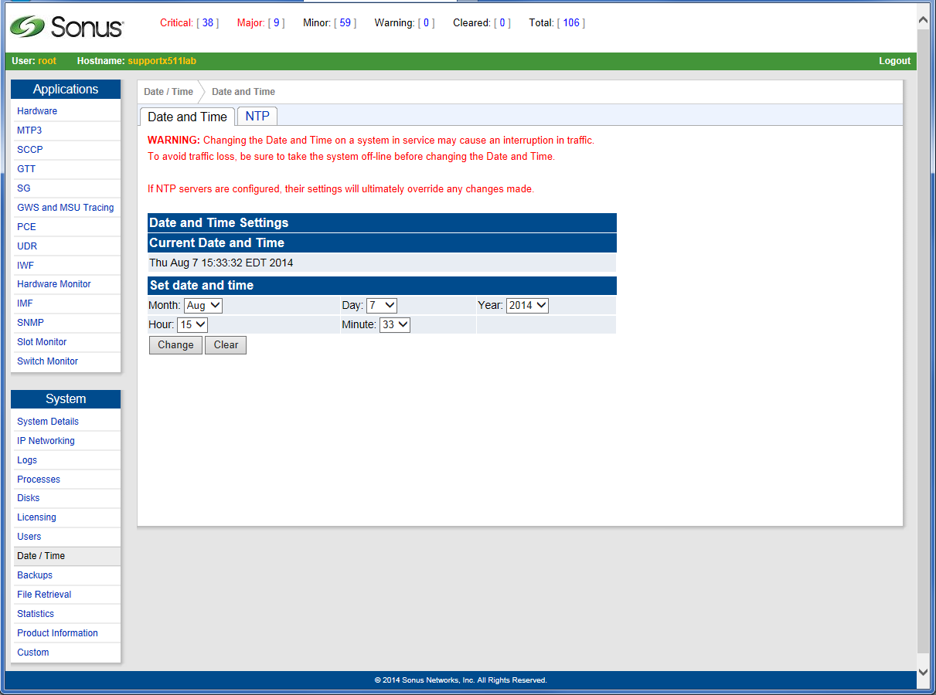
Setting the Date and Time
Setting date and time
From the Main Menu, click menu, select Date/Time
Using the drop-down lists, select the date and time as required
Click Change
Note: It may take a few minutes for all cards to synchronize the date/time

Slide 104
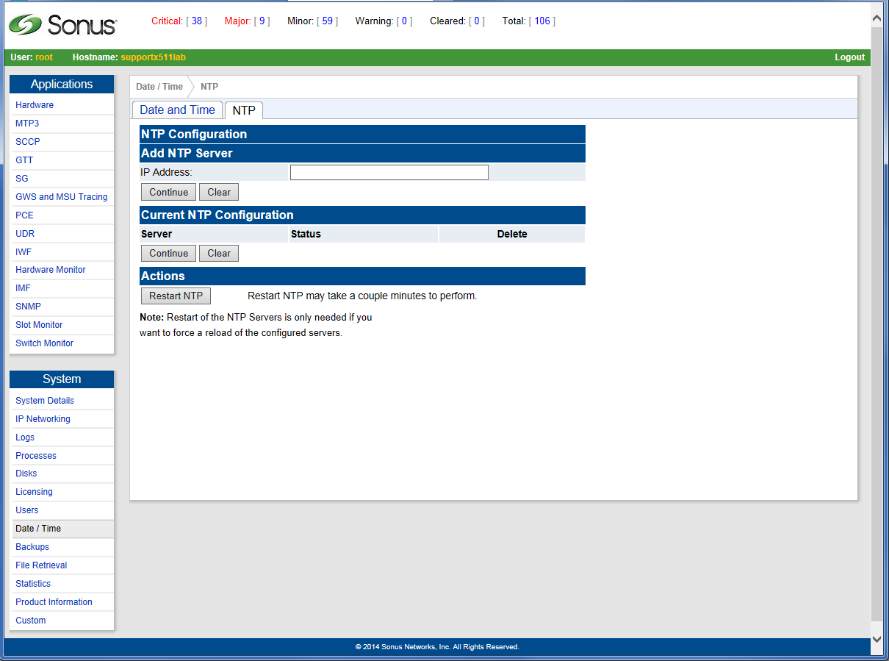
Adding NTP Servers
Provisioning NTP server(s) allows the DSC 8000 to synchronize time with external NTP server(s)
From the Main Menu, click Date/Time.
Click NTP.
Enter the NTP server’s IP address in the hostname or IP text box, and then click Continue.
Click Restart NTP.

Slide 105
Managing Users and Passwords
New users are forced to change password on first login
Passwords should have at least one character of each class type
The 4 classes are Lower Alpha, Upper Alpha, Numeric, and special characters
Min of 8 characters required if all 4 types are used
Min of 10 characters required if 3 types are used
Min of 14 characters required if 2 types are used
Example valid password: DSC123_lab!
Newly created users default in profile UNPROFILED

Slide 106
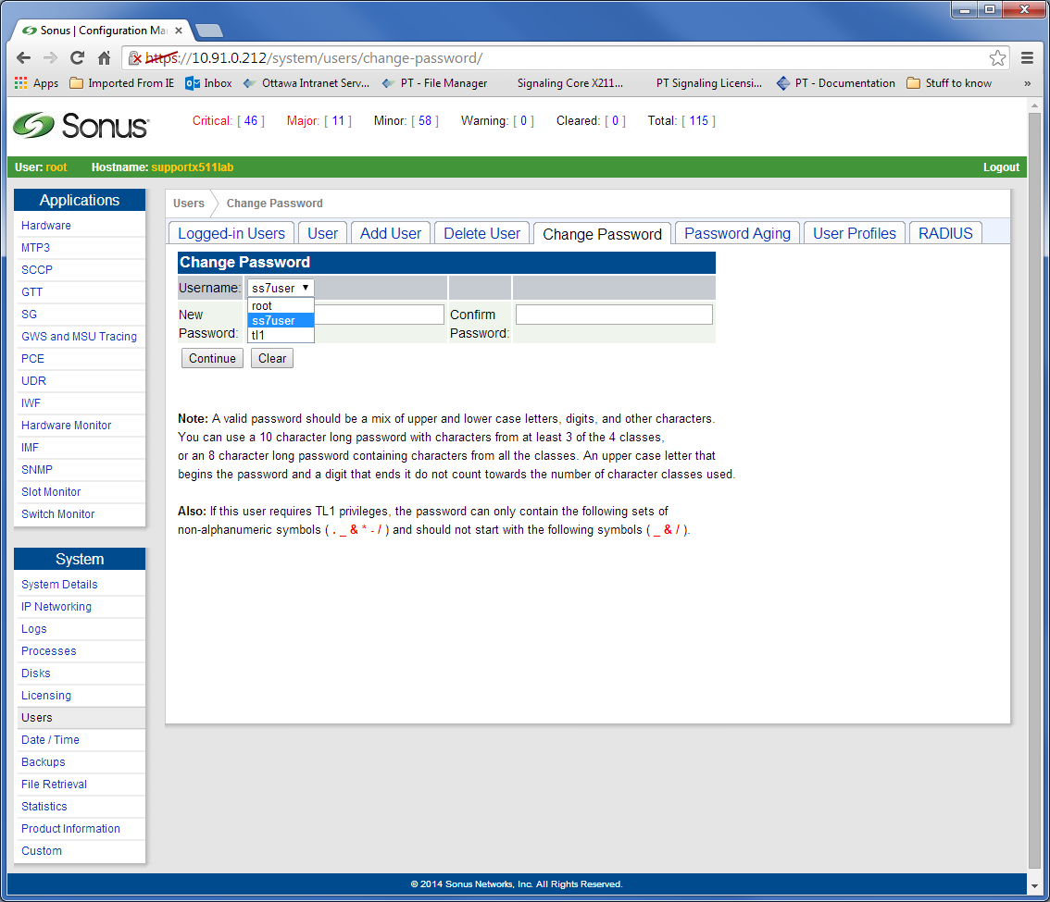
Managing Users and Passwords
From the Main Menu, click Users
Click Change password
From the User drop-down list, select the user type (root, ss7user, or tl1).
Enter the new password as required, confirm the new password by re-entering it, and then click Continue.
Click Continue.

Slide 107
Managing Users and Passwords
Only the root user can add or delete system users
Any new system users that are created (added) are assigned (UNPROFILED, RO)
To add a user
Add a user
Assign user profile

Slide 108
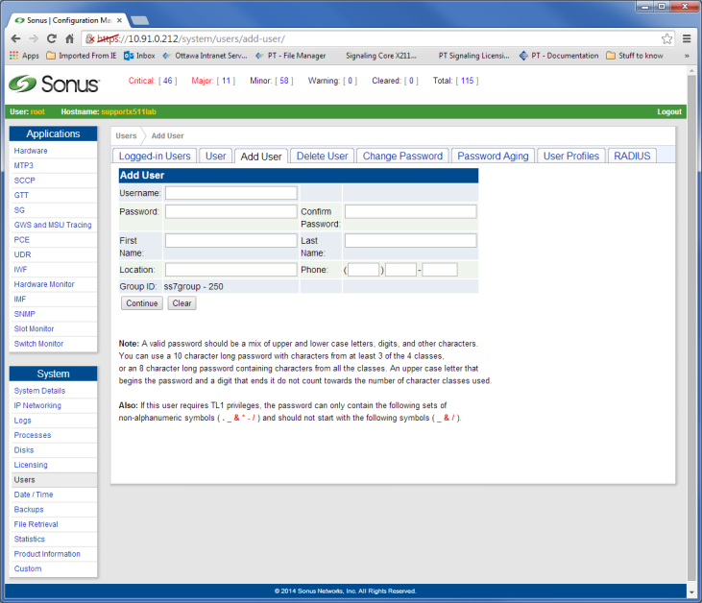
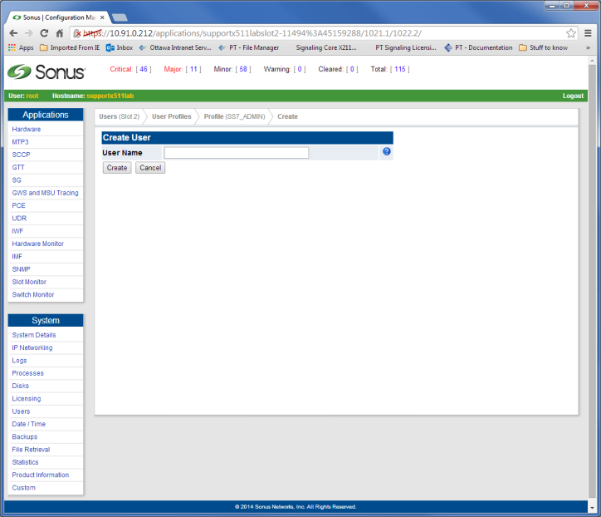
Managing Users and Passwords
Adding a User
From the Main Menu, click Users
Click Add User
Click User Profiles
Click the required user profile
Click Create User
Enter the name of the user you just created.
Click Create.

Slide 109
Configuring RADIUS
RADIUS (Remote Authentication Dial-In User Service) allows an external server to provide centralized Authentication, Authorization and Accounting (AAA) to multiple clients.
Runs on the application layer using the User Datagram Protocol (UDP) transport.
If RADIUS is enabled on the system and the user exists on the RADIUS server, the credentials configured for the user on this server are used instead of UPP

Slide 110
Configuring Radius
The Radius server must be configured prior to connecting to the DSC 8000 system
root user can enable Radius on the DSC 8000 system
The RADIUS server configuration is retained across system restarts and loss of power
An alarm is raised if one or more of the RADIUS servers has/have become unavailable.
The alarm is cleared when the server(s) become(s) available again.

Slide 111
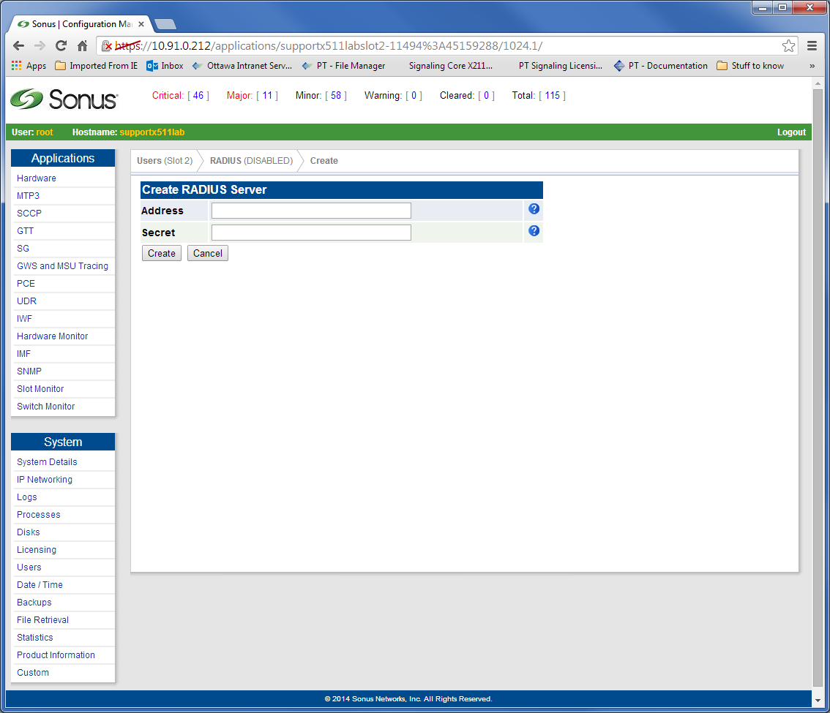
Configuring RADIUS
From the Main Menu, click Users
Click RADIUS
Click Create RADIUS
Click Create
Click Enable

Slide 112
Operation and Maintenance

Slide 113
Operation and Maintenance
System Monitoring
Access Security
Data Measurements
Configuration Backup and Restore
Software Version

Slide 114
System Monitoring
Alarm Dashboard and MSAC
SNMP
System Logs
Integrated Monitoring Feed (IMF)
Processes

Slide 115
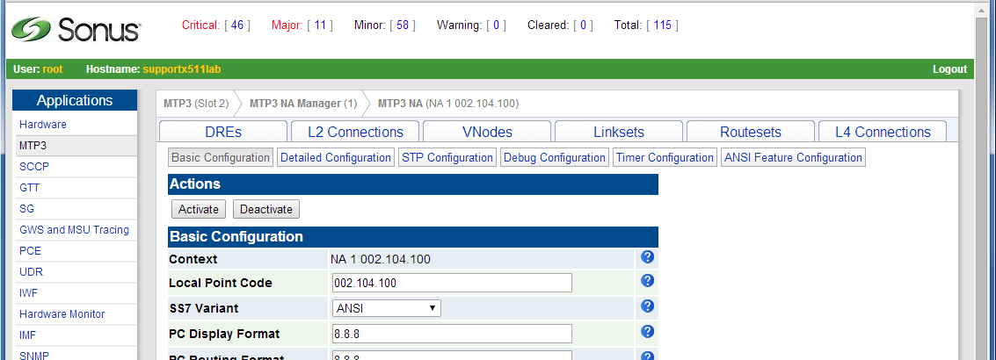
System Monitoring - Alarm Dashboard
Alarms raised on the system appear on the Dashboard
Readily available at the top of each screen
Click severity button to obtain a list of active alarms

Slide 116
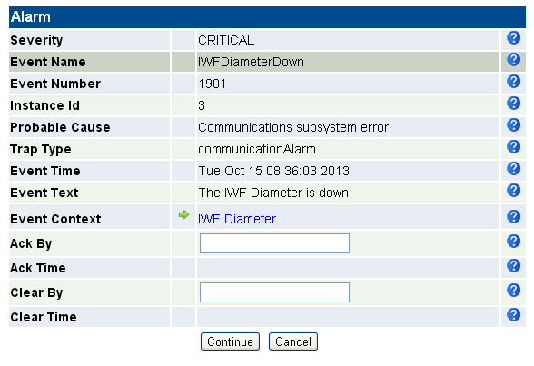
System Monitoring - Alarm Dashboard
Click Event ID and then alarm date for more details
Alarm can be manually acknowledged (still active) and/or cleared
Navigate directly to affected component

Slide 117
System Monitoring - Alarm Dashboard Continue
New important alarms have been added to alert the user the USB key is inserted into to intended SLOT to be REBOOTED – it is important to check the Alarm Dashboard before Rebooting.
The alarm and events id are: 3154 and 3155 for setting and clearing.
Leaving a USB device plugged into a CPU card by accident could result in an extended service outage during maintenance activities where card reboots are performed as a part of a normal procedure. It could also prevent a CPU card from recovering from a fault that triggers a card reboot.
Support staff may only have terminal access to the system, thus there should be a procedure to query the alarm state from the command line. For example, if a USB device had been inserted in a card several days prior, there should be a way to check for any currently raised alarms

Slide 118
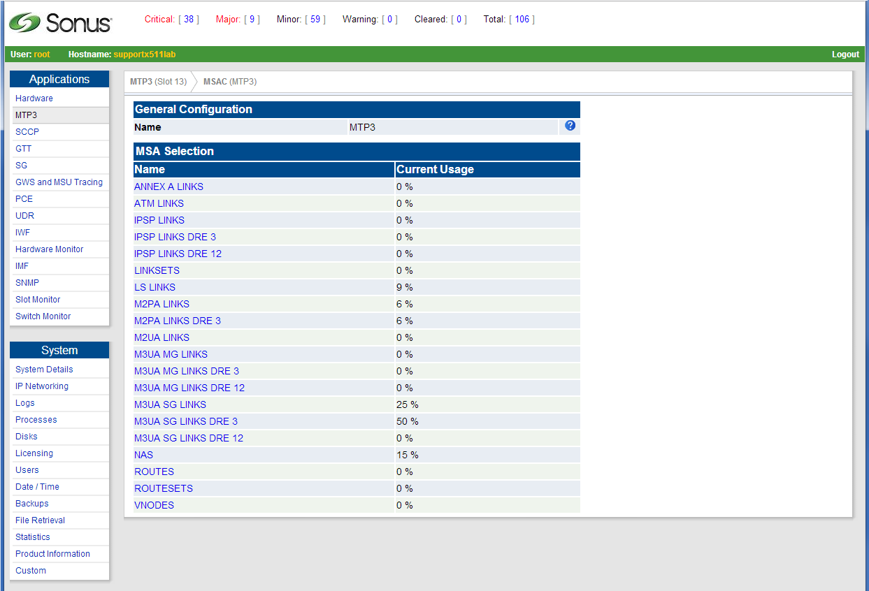
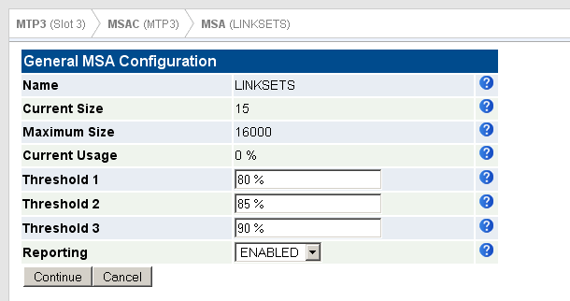
System Monitoring - Memory Space Accounting
Using the Memory Space Accounting (MSAC) provides accounting of either licensed or maximum system capacities.
You can make sure that there is enough capacity for all objects before provisioning the system
You to monitor these objects during system operation.
From the Main Menu, click DSC
Click MSAC
Click the required MSA

Slide 119
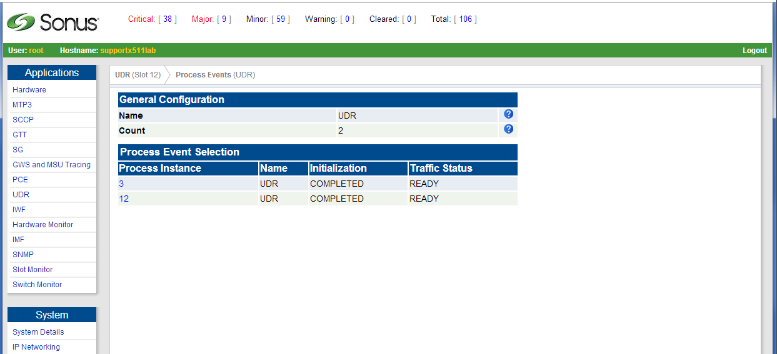

System Monitoring - Process Events
Process Events feature ensures that the applications in all slots function as expected
If the application and its peer does not function as expected, an alarm is raised that is visible on the alarm panel
From the Main Menu, click the required application
Click Process Events
Click the required Process Events

Slide 120



System Monitoring - Slot Monitor
The Slot Monitor
- Displays the Slot Details
- Lists the applications running on the system card in a slot
- Provides the status of the application running on a card in a slot
- Raises alarms by card state, IP configuration state, and application state
- Assists with inserting and extracting system cards
From the Main Menu, click Slot Monitor
Click the required slot
Click the required application

Slide 121



System Monitoring - Switch Monitor
The Switch Monitor monitors the physical IP cable connections and the remote node.
- Displays the number and type of Ethernet Switches
- Shows the availability of the Ethernet Switches and their configuration
- Shows the availability of Ethernet ports and their configuration
- Allows you to enable or disable Ethernet ports
From the Main Menu, click Switch Monitor
Click the required Ethernet Switch
Click the required Port Number

Slide 122
System Monitoring - SNMP
SNMP defines message packaging and transfer between a device (Agent) on the network and one or more SNMP remote monitoring Managers
SNMP uses Net-SNMP open source V1 RFC1157, V2c RFC1441, and V3 RFC2570
The DSC 8000 can send SNMP traps to up to 4 remote hosts
Information about SNMP agent is compiled in the Management Information Base (MIB)
The system supports SNMP walks, sets and gets as an agent on the network
Note: SNMP host must compile the MIB located in directory /opt/cpu_ss7gw/current/mibs

Slide 123



System Monitoring - SNMP
The first step to forward alarms to an external SNMP server is to provision a Trap Host
Click SNMP from the Main Menu
Click Trap Host List
Click Create Trap Host
Enter the IP address of the SNMP server and click Continue
The new server appears on the list of trap hosts
Up to four trap hosts can be added

Slide 124


System Monitoring - SNMP
The DSC 8000 keeps a buffer of up to 1000 traps
To view past traps, from the SNMP Top Menu, click Trap Log
Click the required trap to view trap details

Slide 125


System Monitoring - SNMP
You can suppress events from the Dashboard and/or SNMP
From SNMP Top Menu, click Event Type List to list all system events
Click the unwanted event
Using the SNMP Trap and Dashboard drop-down list, select DISABLED
Click Continue

Slide 126
System Monitoring - Configuring Logs
Log Monitoring Tool Located On Board
Provides Advanced Searching Capabilities
Allows Real-Time Browsing of Logs
Entire log or sections can be downloaded to PC
Logs are rotated every 24 hours then moved into Archive directory

Slide 127


System Monitoring - Configuring Logs
From the Main Menu, click Logs
Click the log file you want to view
A static view of the log (ptidbglog, for example) is displayed on the screen
Search the logs using the navigation buttons and text boxes

Slide 128

System Monitoring - Configuring Logs
Log configuration utility allows you to:
Forward certain logs such as system messages and security messages to a defined IP address
Reset syslog configuration to default

Slide 129

System Monitoring - Retrieving Systems Files
Statistics, logs, temporary, and MIB files can be transferred to your PC though the Web UI
From the Main Menu, click File Retrieval
Click the required directory
/var/logs for Logs
/var/stats for Statistics
/tmp for temporary files
/mibs for local MIB files
Click the required file
Open or Save the file to your PC

Slide 130
System Monitoring - Integrated Monitoring Feed
Duplicates traffic to external monitoring application (probe)
Dedicated port BP2 (p19p1.6 and p19p2.7) on MCH Ethernet Switches
Inbound and Outbound messages
Provides
Time stamp (milliseconds)
Sequence Number
DSC Node ID
ADN Connection ID
Message Direction (Inbound/Outbound)
Link Media Type (DIAMETER)
Instance ID
Payload length of the diameter message
Actual Diameter Message

Slide 131

System Monitoring – Wireshark IMF
You can capture MSU packets to a pcap file using the and use the Wireshark network protocol analyzer to examine a fully decoded IMF packet. The packets are DSC tagged specific.
The plugins are located in the File Retrieval /plugins menu under the System heading from the CMU.
Example Decode

Slide 132

System Monitoring – Wireshark IMF
IMF Captures are enabled at the Linkset, SG and Diameter ADN configuration levels. Only IMF Support set to ENALBED is relayed to the capture function.

Slide 133

System Monitoring – Wireshark IMF
Once the IMF Support is set to ENABLD, the capture is started by triggering the IMF Capture function for the time internal configured, up to 600s per capture.

Slide 134

System Monitoring - Configuring IMF IP
The IMF packet capture can be stopped by either you or the IMF Capture Time attribute value
When the IMF Capture Probe is started, an alarm is raised (8402, Warning)
When the IMF Capture Probe is stopped the alarm is cleared (8403, Clear).
For detailed information about building and compiling a Wireshark plugin, see the Technical Note: IMF Wireshark Decoding, 2012-03-28

Slide 135

System Monitoring – Wireshark IMF
Once the capture is completed, you retrieve the pcap file from the File Retrieval menu.

Slide 136


System Monitoring - Configuring IMF IP
Click on IP Networking
Click Network Interfaces
Click on IMF IP Network
Provision the IP address for the corresponding CPU card.
Click Save and Restart Networking
Click IMF
Click IMF Connections
Click Create IMF Connection to provision remote receivers
Enter the attributes as required Note: PT DEFAULT and TCP are the only supported options in drop down at this time
Click Continue

Slide 137


System Monitoring - Configuring IMF IP
The new connection appears in the IMF Connection Selection list.
Click this connection
Enter the IP address and port of the remote receiver
Click Continue
Click Activate to connect the IMF interface with the remote host over TCP/IP
Refer to the UAP User Guide for the IMF message format

Slide 138

System Monitoring - Configuring IMF IP
Click DSC
Click the required DSC Instance and DSC Node
Click Adjacent Diameter Node
Click the required ADN Node
IMF Support is DISABLED by default for all ADN Nodes
To enable IMF, use the drop-down list and select, ENABLED
Click Continue

Slide 139


System Monitoring - Configuring IMF IP
The IMF Sonus Default Protocol is a fixed format protocol used by IMF.
The DSC traffic processes per DSC Instance are designed with an access to transfer the diameter traffic data to the IMF process.
Click IMF
Click IMF Traffic Processes
Click the DSC Instance

Slide 140

System Monitoring - Configuring IMF IP
You can configure debug logging for IMF
From the Main Menu, click IMF
Click Debug Configuration
Configure the attributes as required.
Note: It is recommended that with the exception of Errors, all other attributes are set to NOT LOGGED for live systems

Slide 141

System Monitoring - Configuring IMF IP
This illustration shows the information flow between the IMF and Wireshark.
The IMF processes on each routing CPU send a copy of the MSU packet along with header information to a file on the Management CPUs. Then you can download this file to a workstation for Wireshark analysis.

Slide 142
System Monitoring - Configuring IMF IP
IMF creates and sets up the Automatically Generated Connections (AGC) to the IMF Capture Probe
The application then runs the tcpdump tool to save the MSU packets arriving at the IMF Capture Probe to file /var/log/packet_capture.pcap
You can access this directory using the File Retrieval utility
Note: If a packet_capture.pcap file already exists when a new packet capture is initiated, this file is overwritten by the new packet_capture.pcap file
When the MSU packet capture stops, the IMF connections created for this capture are destroyed and the Tcpdump process is stopped
After the MSU packet capture is completed, use the Web UI to retrieve the packet_capture.pcap file to your computer and open with Sonus-enabled Wireshark. Ensure that the Sonus headers and payloads are displayed correctly, and that all the traffic sent during the capture is available.

Slide 143

System Monitoring - Configuring Processes
You can stop/start various system processed and monitor several system processes
To stop/start a system process, click Processes
Click System Start/Stop Commands
Select the card the on which you want to stop a process
Click the required radio box
Click Continue.
Other useful functions available from top menu bar
Memory Usage (threshold)
CPU Load Threshold

Slide 144
System Monitoring - Configuring Watchdog
The DSC 8000 platform has a built-in watchdog deamon (WD) to reduce manual intervention during software failures
WD monitors and restarts any processes that are not responsive
WD starts processes that are not running
Status of monitored processes can be viewed
The number of times WD restarts/starts processes is kept in memory and logged
Default configuration should not need any modifications and its recommended to not change unless directed by the Sonus TAC

Slide 145

System Monitoring - Watchdog Processes
To view Watchdog process details, click Processes
Click Watchdog Processes
Select the required slot
The list of monitored system processes are displayed Note: The list of processes may vary due to licensing differences

Slide 146
System Monitoring - Watchdog Processes
Field | Description
WID | Watchdog ID for the process. The ID does not change for each process
PID | Process ID assigned by kernel. ID will change if process restarts
STA | Status of process. Valid options: R (running), S (sleep), ‘+’ (monitored), and ‘-’ (detached)
RPT | Restarts via Process Termination, i.e. number of times a process was started after it went down
RHT | Restarts via Heartbeat Timeout, i.e. number of times a process was restarted after it was unresponsive to heartbeats within time allowed (HTV)
HTV | Heartbeat Timeout Value. Default is 10 seconds
HTT | Current value of Heartbeat Timeout Timer, i.e. time left until the process is restarted
COM | Actual command line of the process being monitored

Slide 147
Access Security
User Passwords
Firewall
IPSEC
TLS

Slide 148
Access Security – User Passwords
Stringent password rules must be followed
New users forced to change password
Access lockout after five login failures (lockout for one minute) Objective is to interrupt mechanized password-cracking algorithms.
The threshold and interval for the lockout can be configured using script blocksshd_config from the CLI. Recommended not to be changed unless directed by Sonus TAC.
Password aging
Password aging disabled by default. If feature is turned on any value between 10-365 days is valid. Default value is 30 days. This global setting applies to all users of system.
Firewall
Iptables rules are turned on by default. Firewall can be turned off temporarily or permanently.

Slide 149

Access Security – User Passwords
To configure Password Aging, click Users
Click Password Aging
Configure the required attributes
Click Continue
To configure User Inactivity Timeout enter value in mins to user WebUI to timeout.

Slide 150
Access Security - Firewall
The DSC 8000 is deployed with a pre-configured IP firewall
This firewall uses standard Linux IP tables to build filtering rule set
Refer to www.netfilter.org for more details
The Firewall can be disabled but it is recommended that it remains ENABLED if the system is exposed to external IP networks
After the firewall is enabled, the only inbound access to the system is through SSH and the Web UI, excluding defined SCTP or TCP connections for software application.

Slide 151

Access Security - Firewall
To view the firewall, click IP Networking
Click Firewall
Select the required system card
Click Update
This example shows the Firewall is Disabled
To start the Firewall, click Enable Firewall
Note: The Firewall is started automatically by default

Slide 152
Access Security – IPSEC and TLS (Diameter Only)
Often not used, or performed by external router
IPSEC
If used, found at edge of network going to other carriers
Provides a higher level of security
Header encryption can hide even the service being accessed,
Less susceptible to some forms of DoS
TLS
If used, found internal to carrier network
Is more flexible
SCTP/TCP header is maintained and can be modified so the message can pass through IP networks more easily

Slide 153
Access Security – IPSEC and TLS (Diameter Only)
Kernel
(operating system)
DSC Instance
IPSec
TLS
Analysis
And Routing
Socket Receive
IPSec
TLS
Destination Routing
Socket Send

Slide 154
Access Security – IPSEC (Diameter Only)
End-to-end (host to host) at IP level
Below application level
Typically performed in Router at IP edge of network (not internal to carrier network)
Optionally performed at DSC level for each CPU
Has a performance impact on DSC Diameter Routing.
Configuration requires
root-access
access to Linux Prompt

Slide 155
Access Security – IPSEC Configuration (Diameter Only)
On EACH routing CPU
in /etc/sysconfig/network-scripts
Create file ifcfg-<connection name>
DST=<remote host>
TYPE=IPSEC
ONBOOT=yes
IKE_METHOD=PSK
Create file keys-<connection name>
IKE_PSK=Key_Value01
Secure file
Chmod 600 keys-<connection name>
Activate
Ifup-ipsec <connection name>

Slide 156
Access Security – TLS Configuration (Diameter Only)
Application to Application level
Does not modify the IP header information
Used for inter-realm security
Diameter Capability Exchange is done BEFORE TLS handshake
CER/CEA exchange declares that TLS will be used
Certificate based encryption
x.509, one way, PEM format files
No automatic generation or downloading of certificate files, nor Open PGP style
Each virtual DSC Instance has
its own certificates
Certificate Authority (CA) certificate
Its own private key
Certificate Authority is third-party and is not supplied by Sonus

Slide 157

Access Security – TLS Configuration (Diameter Only)
In DSC Instance, create a Security Parameter Set with type of TLS.
In IP Networking -> IP Security, upload certificates to this file set.
In DSC in Adjacent Diameter Node Connection, use new Security Parameter Set.

Slide 158
Data Measurements
Statistics
File Formats
Examples

Slide 159
Data Measurements - Statistics
Data measurements (statistics) allow evaluation of the system performance
Data is recorded in real-time and saved to disk
Rotated every 24hrs and moved to compressed directory after 7 days
CSV file format permits convenient off-system analysis
Many different categories of statistics files are generated based upon the type of licensing and features used.

Slide 160
Data Measurements - Statistics
Measurements buffer keeps five minutes of data
Stats collector agents (SCA) receive data every five minute interval
SCA writes to files on disk /var/stats in CSV format
Retain 7 days worth of data and/or up to 20% of HDD (compressed archives)
Accumulation intervals: 5min, 30min, 24hr
Files are cycled at 00:00 every day
One file per report interval for each category for each day

Slide 161
Data Measurements – File Formats
File names
<stats type>-<interval type>-<yyyy-mm-dd>
Example: Linkset-day-2010-01-03
Each line contains
end time, instance, duration or measured value
File content
version=<major>.<minor>
date, instance,<comma-delimited statistics names list>
date, instanceA, <value1>, <value2>, ...
date, instanceB, <value1>, <value2>, ...

Slide 162


Data Measurements - Example

Slide 163
Backup and Restore
Destination Definitions
Mail Servers
Manual Backups
Automated Backups
System Backup to USB Key
Restore Backups

Slide 164
Backup and Restore
The DSC 8000 supports system backup and restore functionality
Configuration backed up then restored in case of user error or hardware failure
Backups can be automatically or manually sent to remote destinations for safety and security
Easy to configure and recommended to be made at least once after a system is ready (configured) to go live
Each Management CPU card creates a backup of all configuration files
Only one backup file is needed for restoring data
Full system backup to a USB key is also supported
Caution: If you are using a USB key for system software backup or restore, or service pack installation, make sure to remove the USB key after you completed any of these processes. Otherwise, when the CPU reboots the next time, this card may attempt a reboot of the USB key.

Slide 165
Backup and Restore
The default page lists scheduled backups, if any
A default Directory created automatically for /opt/backups
Backup methods
Automated
Manual
Complete system backup (USB key)
The disk space designated for local backups is 20Mb
Backup Destinations:
Local Directory
FTP to a Remote Directory
E-Mail Recipient
TFTP to a Remote Directory
SFTP Destination

Slide 166


Backup and Restore – Destination Definitions
To configure a backup destination, click Backups
Click Create Destination Definition
Select the required backup destination
Click Continue
Note: For destination E-mail Recipient, the system mail server must be configured (next slide)

Slide 167

Backup and Restore – Mail Server
Click IP Networking
Click Mail Server
Enter the address of the system E-mail server
SMTP server must accept connection
You may test the configuration by sending an E-Mail

Slide 168

Backup and Restore – Manual Backups
To create a backup immediately, click Manual Configuration Backup
Select the type of backup under Fileset Definitions and the backup destination
Select a Destination Definition
Optionally, add a comment about the backup
Click Continue
In this example, the system attempts transfer the backup files to the default backup directory

Slide 169

Backup and Restore – Automated Backups
To schedule a backup, click Automated Configuration Backups
Click Create New Automated Backup
Select
Day and time for backup
Fileset Definitions
Backup Destination
Optionally, add a comment
Click Continue

Slide 170

Backup and Restore – System Backup to USB Key
Before proceeding, a USB key must be connected to one of the Management CPUs or its respective RTM
To backup the entire system to a USB key, click Complete System Backup
Click Start System Backup

Slide 171

Backup and Restore – Restore Backups
To restore a system configuration, click Restore Backup Files
Select the backup files you want to restore, and click Restore
The backup files selected are restored and activated
The applications are restarted and each card may be rebooted
System login is disabled for up to 5 minutes, and is enabled again after the completion of restore

Slide 172
Software Version
Software Version in CMU
Software Version in CLI
Upgrades

Slide 173

Software Version – CMU
To verify the software version installed on a CPU, click Product Information
Select the required CPU

Slide 174

Software Versions - CLI
SSH to OAM address of the shelf
Login as root
Type startmenu
Select 1 – System
Select 2 – Software Revisions
Select 3 – CPU Versions

Slide 175

Software Versions - Upgrades
Software upgrades can be conduced by Sonus as a paid Service or self performed
Upgrade procedure is performed from the CLI as user root
Automated process moves software to each card sequentially
There is an Express Rollback that can be performed if for some reason, during a system software upgrade, it is decided that a rollback to the previous software is required. If the Express Rollback is initiated, the rollback must be done on ALL system cards.

Slide 176
Software Versions - Upgrades
Software upgrades require advanced planning
System elements are rebooted through the upgrade
The typical DSC 8000 upgrade lasts approximately 4 hours
The typical DSC SWe upgrade lasts approximately 1 hour
Upgrade Guide and Planning MoP
https://support.sonus.net/display/DSCDOC160/DSC+8000+Upgrade+Guide

Slide 177
Course Completed

